Slide 1
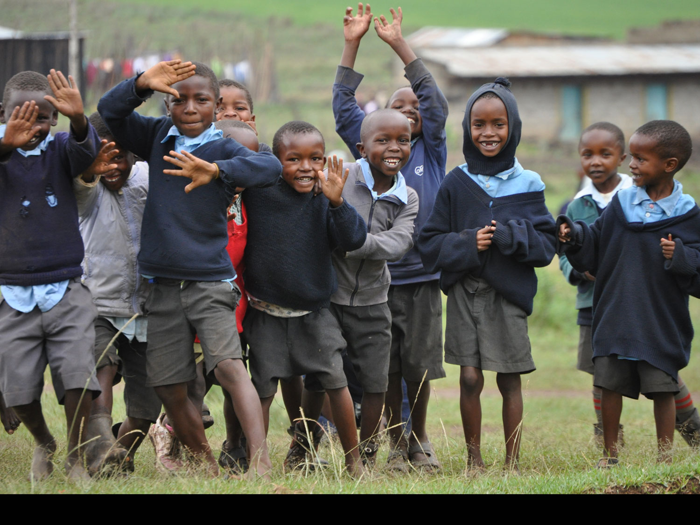
Going to school in rural Africa
Presentation for Primary Schools
2018
build-africa.org
Notes:
Build Africa Presentation for Primary Schools
2018
This presentation will help teachers introduce Build Africa to the school or class during Assembly and tell students what Build Africa does.

Slide 2
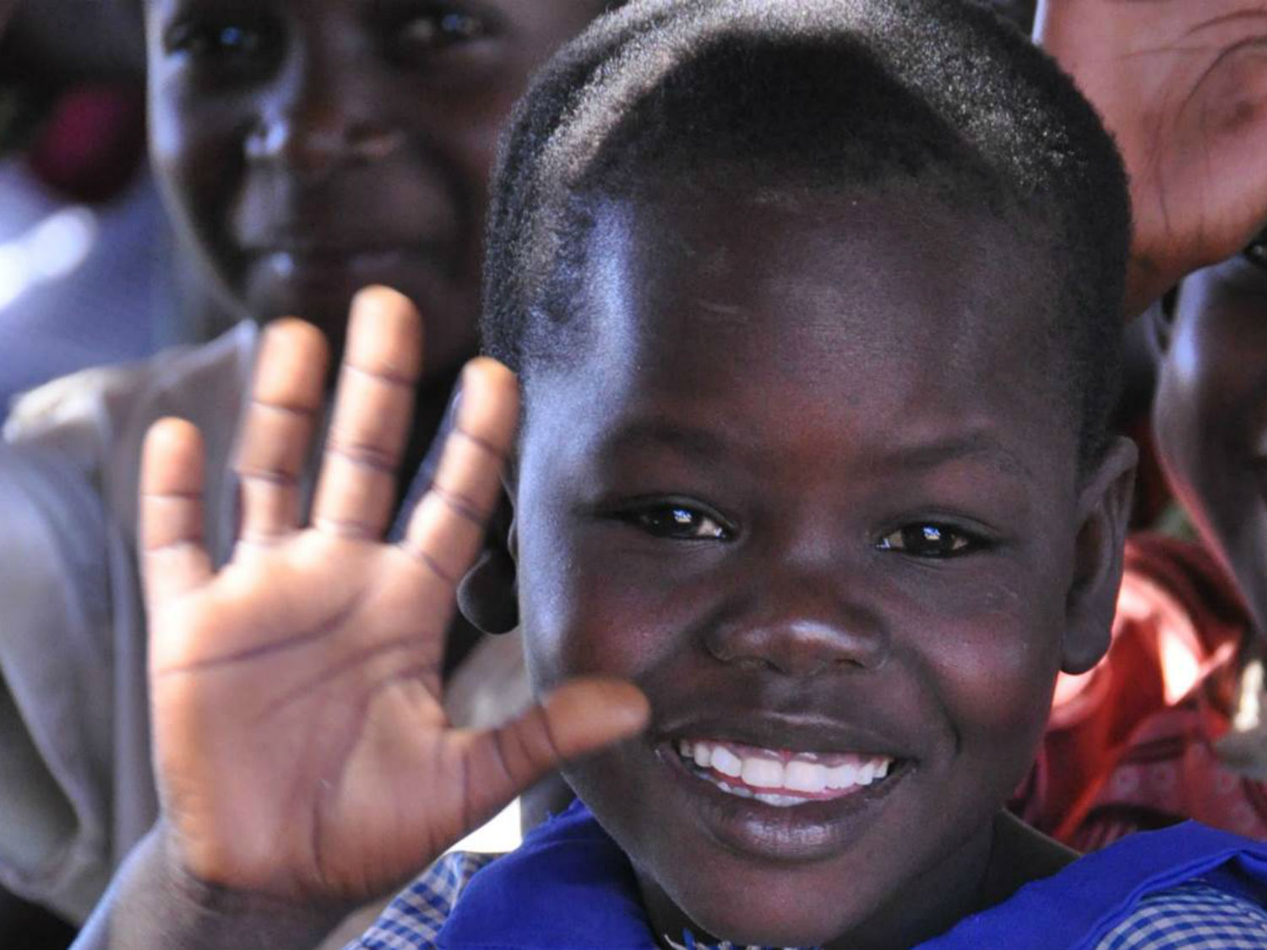
Jambo!
build-africa.org
Notes:
‘Jambo’ is how to say ‘hello’ in Swahili.
Swahili is one of the official languages in Kenya and Uganda.
English is the other official language.

Slide 3
Who we are
Build Africa is a charity with 40 years of experience working in countries where many people live in poverty.
For over 20 years we have worked in Africa to help children go to school and get a good education.
build-africa.org
Notes:
Build Africa is an award-winning charity with 40 years of experience working in international development.
Our vision is people in Africa leading happy, fulfilling lives. We understand the importance of partnering with African communities and our focus is on sustainable, community-led development in both our education and livelihoods work.
Our programme work is delivered by our local partners Build Africa Uganda and Build Africa Kenya, where the teams work closely together to deliver our projects to hundreds of thousands of children and adults.
Watch our videos to learn more about Build Africa:
A story about problem solving: https://www.youtube.com/watch?v=a5mIw8Oerag
Time machine: https://www.youtube.com/watch?v=roTcOzCy4hE
Literacy is the start of the story: https://www.youtube.com/watch?v=mftz1xdErdw

Slide 4
The aims of our work
The United Nations wants children everywhere to have a good education. (Sustainable Development Goal 4).
So Build Africa helps children in rural Kenya and Uganda go to school.
Our vision
People in Africa leading fulfilling, happy lives.
Our mission
To partner with African communities to create lasting educational and livelihoods opportunities.
build-africa.org
Notes:
Sustainable Development Goal No. 4:
Ensure inclusive and equitable quality education and promote lifelong learning opportunities for all.
Below are highlighted the targets within SDG No.4 which Build Africa will focus its impact measurements on:
4.1 - By 2030, ensure that all girls and boys complete free, equitable and quality primary and secondary education leading to relevant and effective learning outcomes
4.2 - By 2030, ensure that all girls and boys have access to quality early childhood development, care and pre-primary education so that they are ready for primary education
4.a - Build and upgrade education facilities that are child, disability and gender sensitive and provide safe, non-violent, inclusive and effective learning environments for all
http://www.un.org/sustainabledevelopment/sustainable-development-goals/

Slide 5
The aims of our work
Our model
Build Africa has one ultimate goal – we want to see every child in school, and every child learning!
This goal is split in to three outcomes:
No child is denied an education
Every child in school gets the chance to learn
Every child leaves school with the skills they need
build-africa.org
Notes:
No child denied an education
Poverty and discrimination remain the two key barriers preventing children enrolling and then regularly attending school.
We aim to help children overcome the barriers that prevent them from going to school, including tackling inequality in their community and working with parents to provide for their families.
Every child in school gets the chance to learn – bringing learning to life
Children in rural areas often struggle to have access to schools. When they do, classrooms can often be old, badly built, or insufficient in number – leaving children without an appropriate place to learn and play. Learning resources are scarce and often poorly designed. Limited access to clean water and hygienic toilets also put children and teachers at risk of dangerous but preventable diseases.
We ensuing that schools are safe, healthy and well equipped, and that every child gets the chance to learn. We aim to help children have the best possible education during their time at school in a safe and engaging environment.
Every child leaves school with the skills they need
Training and mentoring is vital to quality teaching, but few staff receive support beyond their basic qualification. Teachers often have to use outdated or ineffective methods that cause children’s education to suffer and lead to higher dropout rates. Poor support can also lead to a lack of motivation, meaning teachers don't show up for work or use their skills properly.
We aim to help children learn the skills they need from well-trained and properly supported teachers, so that they can leave school with an education to match their ambition.

Slide 6
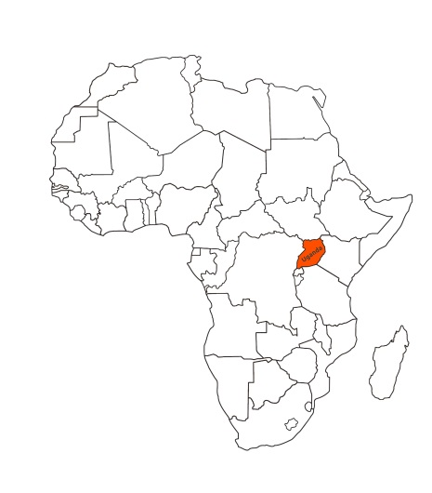
Where we work
build-africa.org
Notes:
We work in remote and rural regions of Kenya and Uganda where many people are surviving below the poverty line – meaning children are leaving school without the basic skills they need. We work in these areas because they are the most marginalised, the most poor, the most in need of support. For example, poverty levels in Kwale, Kenya are 71%, and more than half the population in Bukedea, Uganda live below the poverty line.
Kenya: districts of Kwale, Machakos and Nakuru
Uganda: districts of Bukedea, Buliisa, Kiryandongo, Kumi, Masindi, Ngora and Oyam
https://www.scribblemaps.com/maps/view/Build_Africa_/BuildA
According to a recent government survey, 16.5 million Kenyans - over half the entire population - live below the poverty line. Approximately 60% of Kenya's population is comprised of persons under the age of 30. Most of them are either in school or not gainfully engaged after school since long term unemployment is high.
A survey conducted by the Uganda Bureau of Statistic (UBOS) in 2016 reported that 10 million people in Uganda live in poverty – that’s almost a quarter of the population. According to The World Bank, 84% of people living in Northern / Eastern Uganda live below the poverty line. Uganda faces widespread deprivation in several non-monetary dimensions of poverty, such as sanitation, access to electricity, education (completion and progression), and child malnutrition.
Improved education is a priority of the Ugandan government. In 1997 Universal Primary Education (UPE) was introduced, with enrolment rising from 2.5 to 6 million pupils. in 2007 the government went one step further and made secondary education free. While it is now the single biggest item in government spending, finances are limited and schools are completely overstretched. There is a serious shortage of teachers, which leads to poor quality education and a low level of literacy among school leavers. One in five primary school children are orphans and the image of large classes held in the open is a common one in rural Uganda.

Slide 7
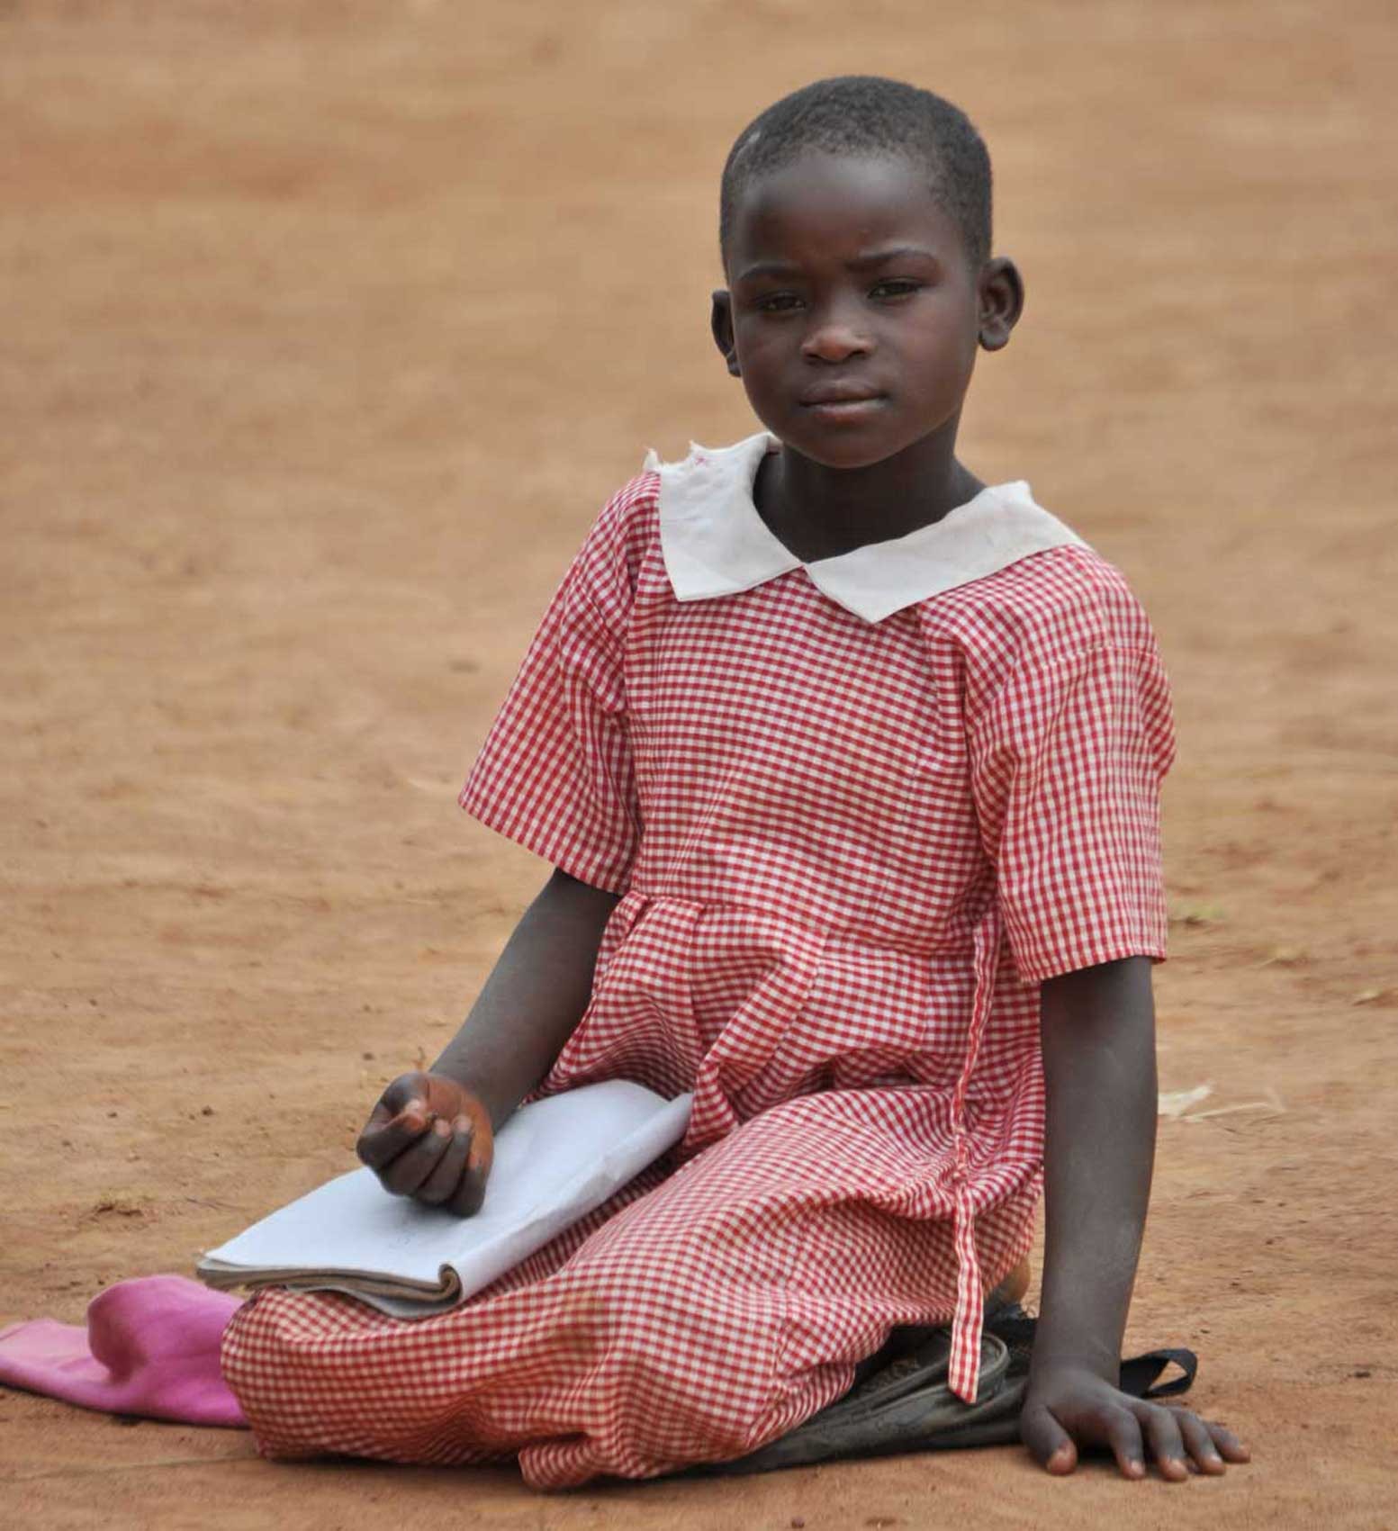
Compare UK and Kenya and Uganda
To start with we are going to think about some of the differences between the UK and rural Kenya and Uganda.
What challenges do people face?
build-africa.org
Notes:
To understand why we support these pupils and communities, we must understand what life is like in rural Africa and what kind of challenges they face.
What do you know about Kenya?
What do you know about Uganda?
Can students suggest reasons why children in Kenya and Uganda might not be able to go to school?
Poverty and discrimination remain the two key barriers preventing children enrolling and then regularly attending school.

Slide 8
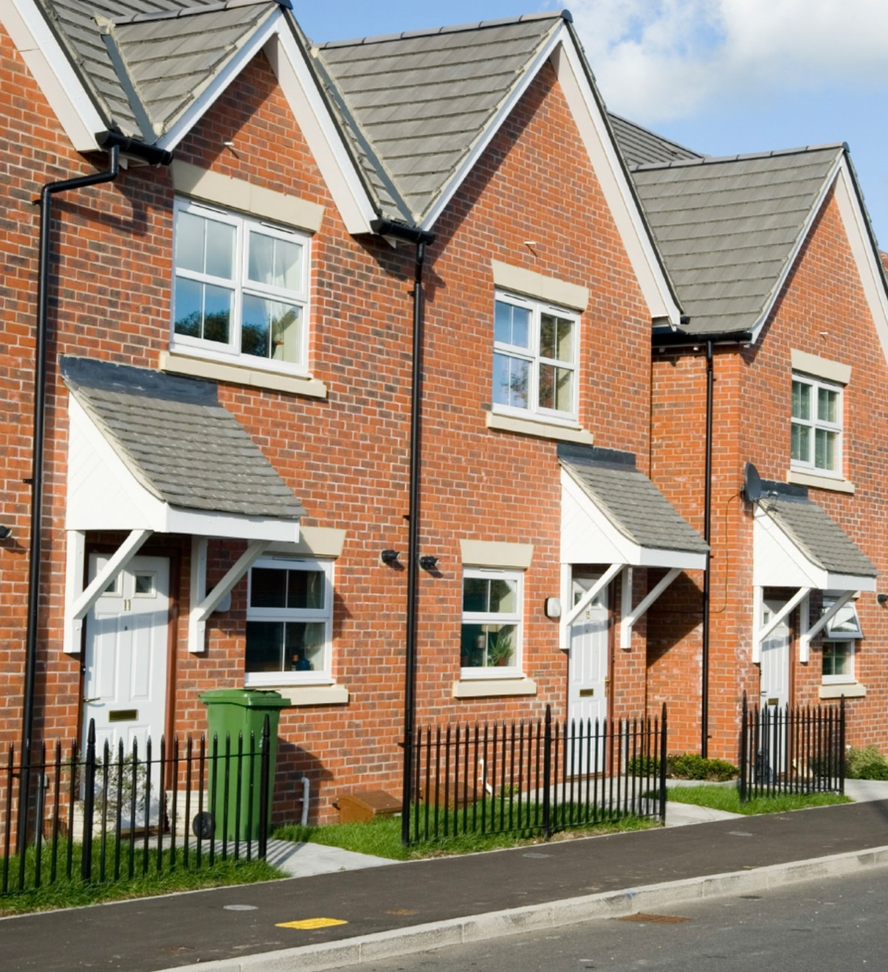
Compare UK and Kenya and Uganda
Where do you live?
What does your home look like?
build-africa.org
Notes:
Where do you live?
What does your home look like?
How big is your house?
Are there lots of rooms?
Do you have your own bedroom or do you have to share a bedroom?
Do you have lots of neighbours?

Slide 9
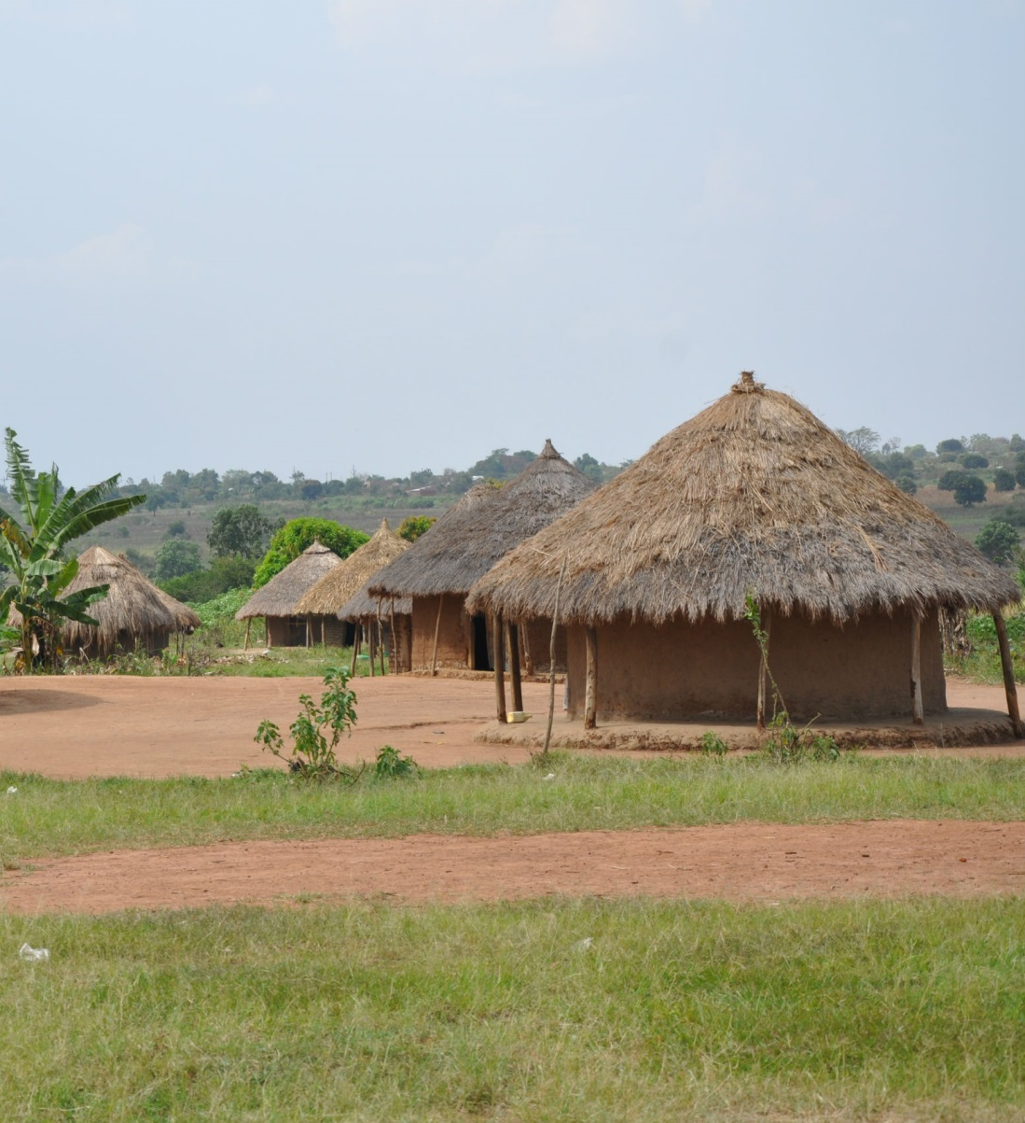
Compare UK and Kenya and Uganda
Is your home very different from a typical rural home in Kenya?
build-africa.org
Notes:
This is a typical home in rural Kenya. Many of the children and young people that Build Africa works with live in houses similar like this.
How do you think it is made?
(Sticks and mud walls and grass / thatch roof)
The mud helps to keep the house cool in the very hot midday sun but when it rains the mud will drip into the house and make a mess.
Is it as big as your house?
How many rooms do you think it has?
(One room)
What do you think is different about it from your house?
(No windows, no electricity, no bathroom, only one room etc.)
Can you see anything that is the same as where you live?

Slide 10
Compare UK and Kenya and Uganda
In the morning do you have breakfast before going to school?
What does your kitchen look like?
build-africa.org
Notes:
In the morning do you have breakfast before going to school?
Where do you eat breakfast?
What does your kitchen look like?
What kind of things will you find in the kitchen?
(Cooker, fridge, sink – with running water, lights – electricity, cupboards)

Slide 11
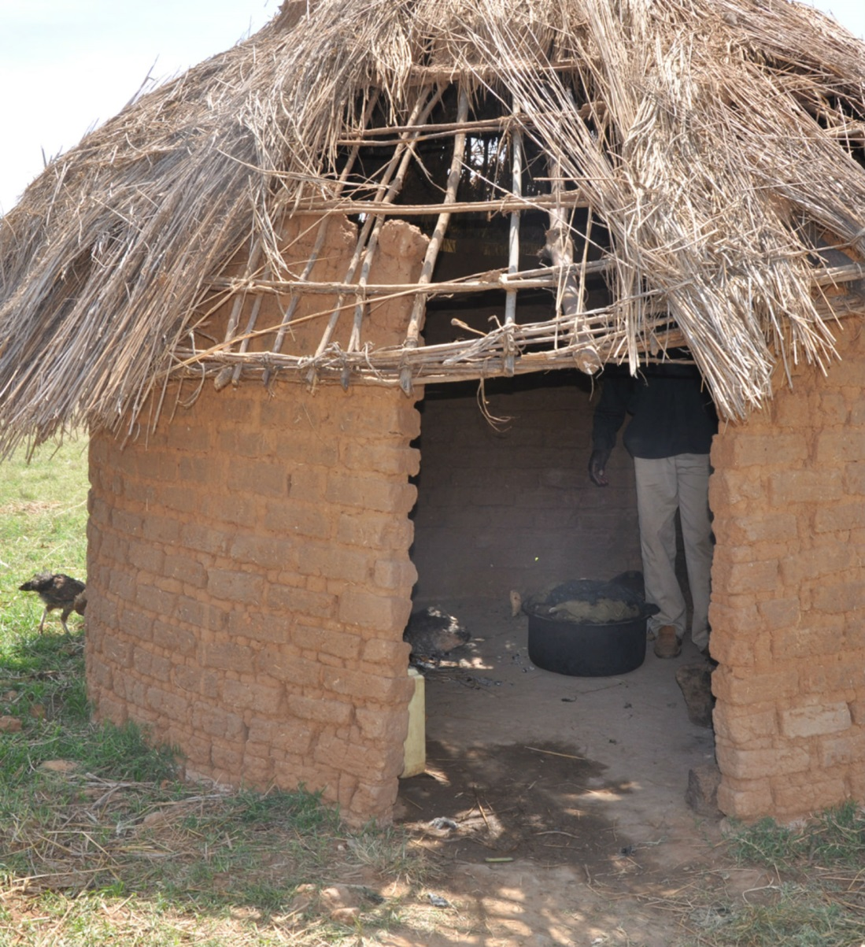
Compare UK and Kenya and Uganda
And how is your kitchen different to this kitchen in rural Kenya?
build-africa.org
Notes:
This is what some kitchens looks like in rural Kenya.
Although not all families have a room to cook in. Some families will cook on a fire outside their mud hut.
Can you see how they are cooking?
(Fire on the floor)
What do you think it is like inside that kitchen?
(Dark, smoky, dusty)
Can you see a sink?
How do think they wash the food they are going to eat?
Or wash their hands?
(Fetch water from the river)

Slide 12
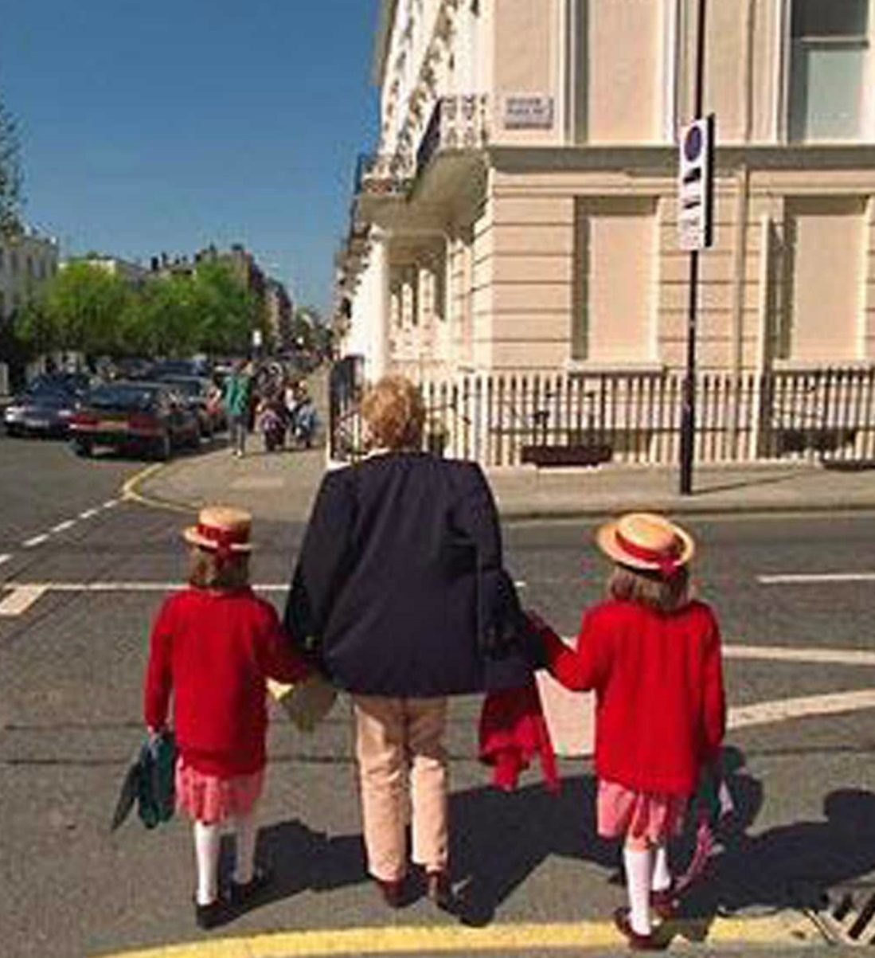
Compare UK and Kenya and Uganda
After breakfast how do you get to school?
Do you walk to school?
Or catch the bus or train?
Perhaps you are dropped off at school in a car?
build-africa.org
Notes:
After you have had breakfast, it’s time to go to school.
How do you get to school?
Do you go in the car with your mother or father?
Do you go in a school bus or ride a bicycle? Do you have your own bicycle?
How many of you walk to school?

Slide 13
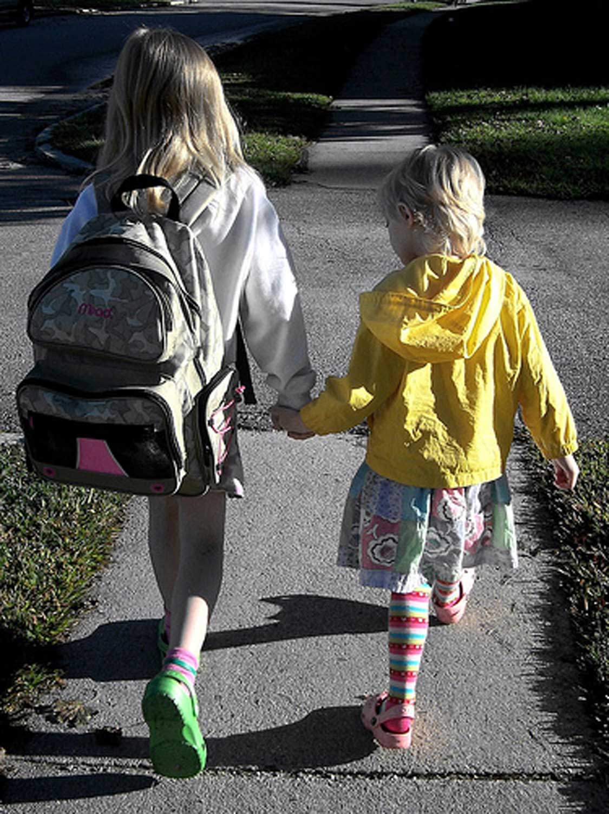
Compare UK and Kenya and Uganda
Some of you walk.
How long does it take to walk to school?
build-africa.org
Notes:
How many said they walk to school?
How long does it take you to walk to school?
Do you get tired sometimes?

Slide 14
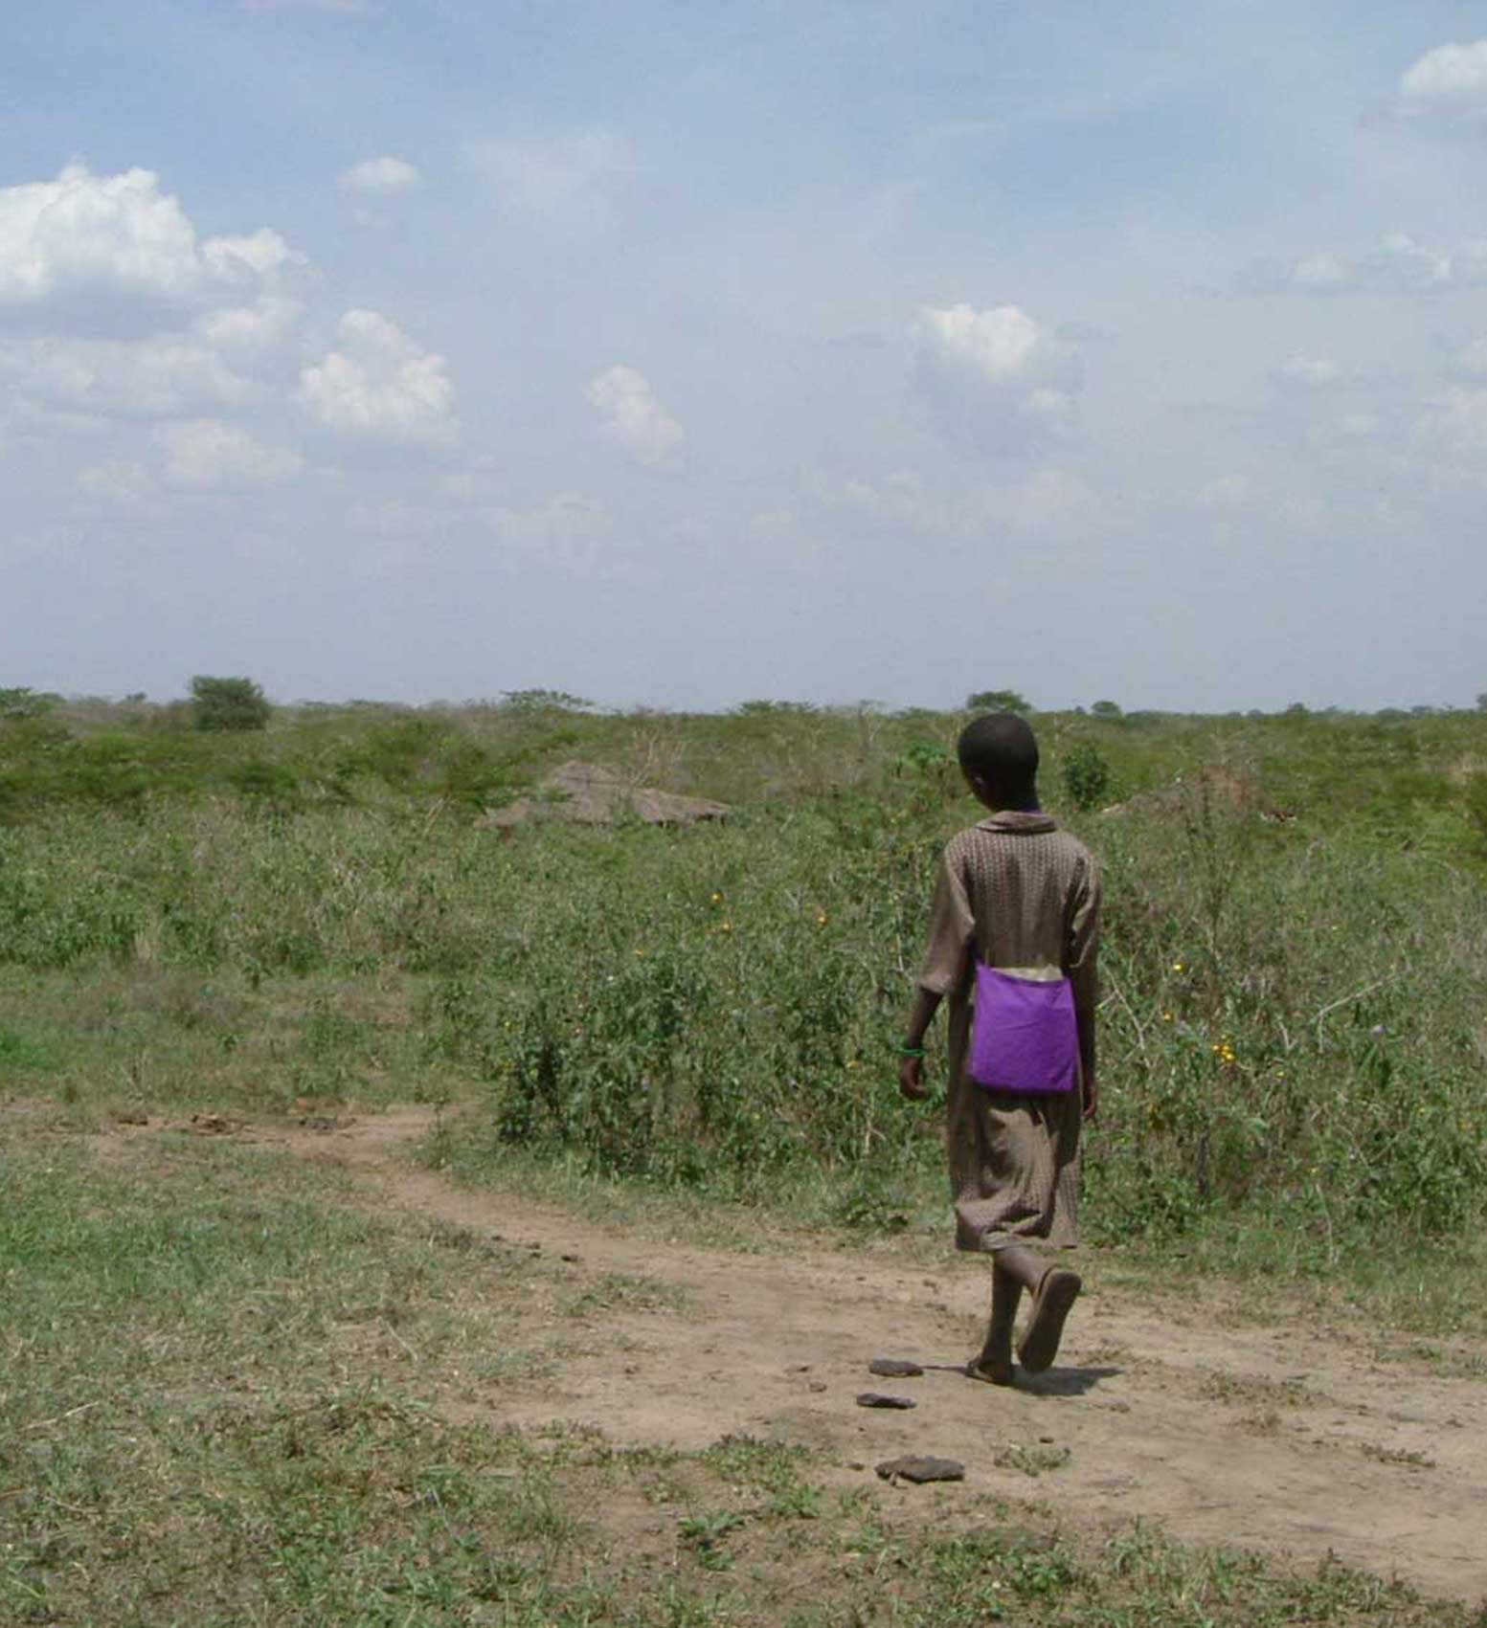
Compare UK and Kenya and Uganda
In Africa almost all children have to walk to school.
It can take some of them over an hour to walk to school.
build-africa.org
Notes:
Almost all children in the village will begin their day having to walk to school because hardly anyone has a car.
A few children may be lucky enough to own a bicycle.
Most children have to walk and it can take a long time because they live quite far away from their school. The children have to walk along the paths in the bush.
And it gets hot in Africa!
Can you imagine if you had to walk a long way to school and it was hot?
Do you think you would be tired when you get to school?

Slide 15
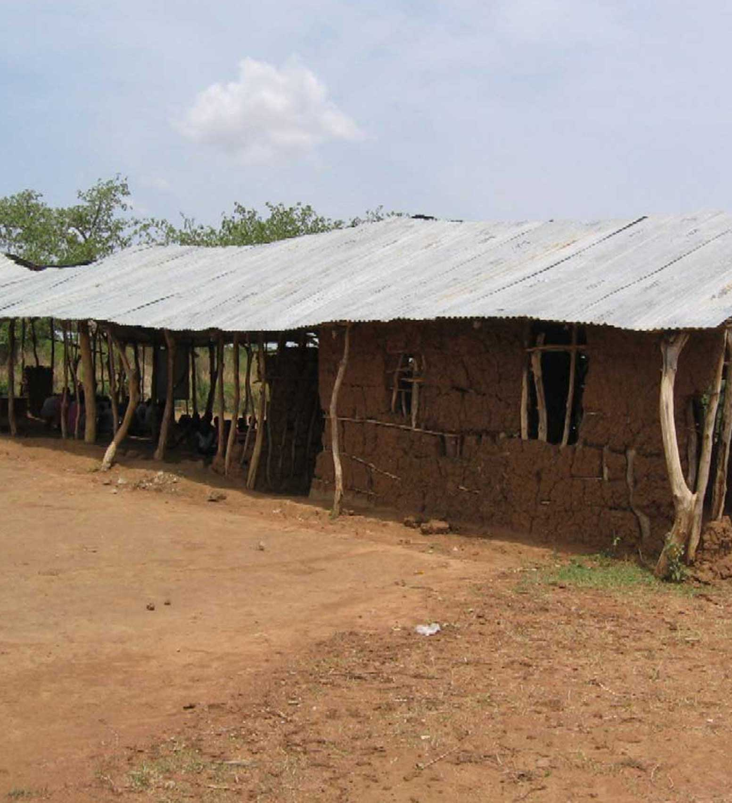
Compare UK and Kenya and Uganda
And when they get to school most of the classrooms are unsafe and look like they are falling apart.
build-africa.org
Notes:
This is what many classrooms look like in rural Kenya and Uganda. The walls are made from sticks and mud.
They will offer some shade from the sun but very little protection against the wind and rain.
Classrooms like this can easily fall down if there is a storm and that makes them unsafe to use.
It is vitally important that a school has safe, purpose-built classrooms that provide both pupils and teachers with shelter from the elements, enabling lessons to continue uninterrupted.
With many of the schools we partner, we find classes being held outside under the shade of trees or in make-shift structures, exposing children – and the few books they have – to the elements.

Slide 16
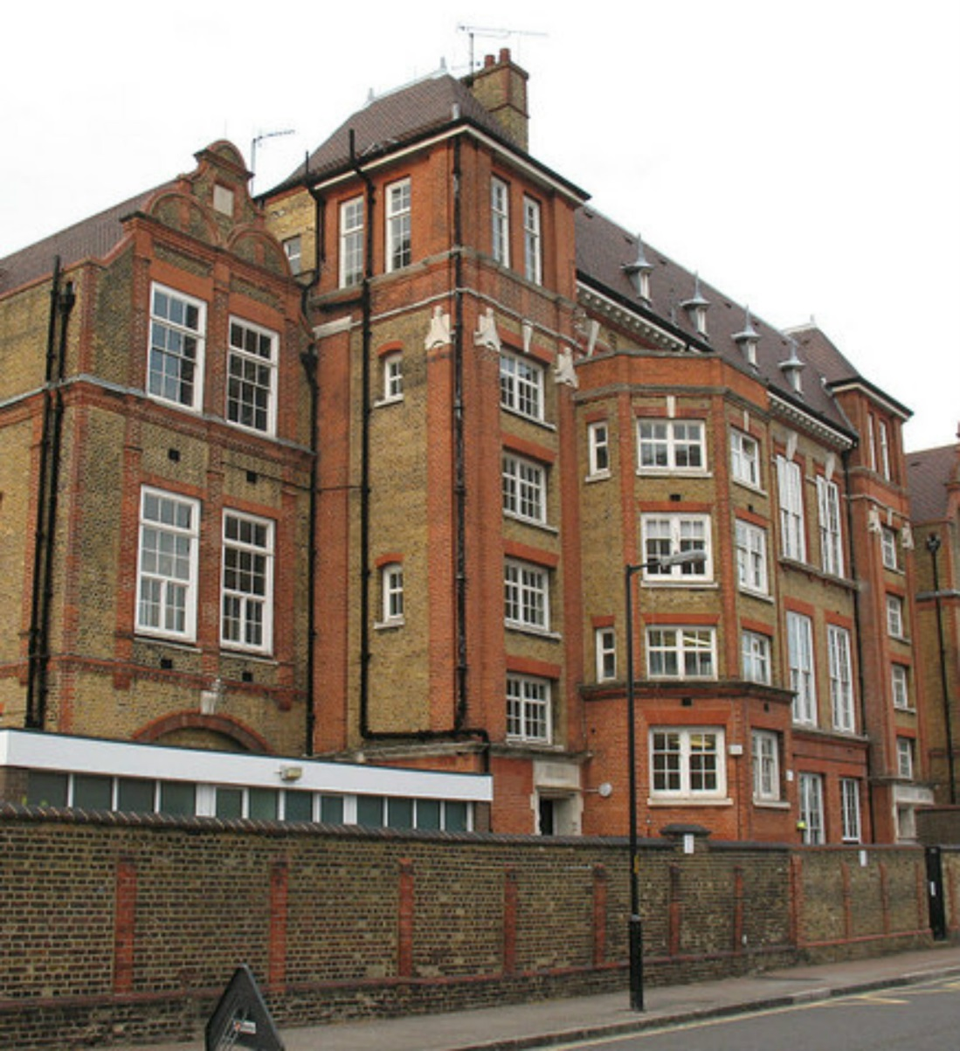
Compare UK and Kenya and Uganda
Think about your school and your classroom and your desks.
Are they very different to a school in Africa?
build-africa.org
Notes:
Think about your school and your classroom. Do you think it is easier for you to come to school and learn than it is for the children in Africa?
Why?
(UK school is warm in winter, shady in summer, it is safe and not going to fall down in a storm, classrooms have enough desks for all the children, everyone has books)

Slide 17
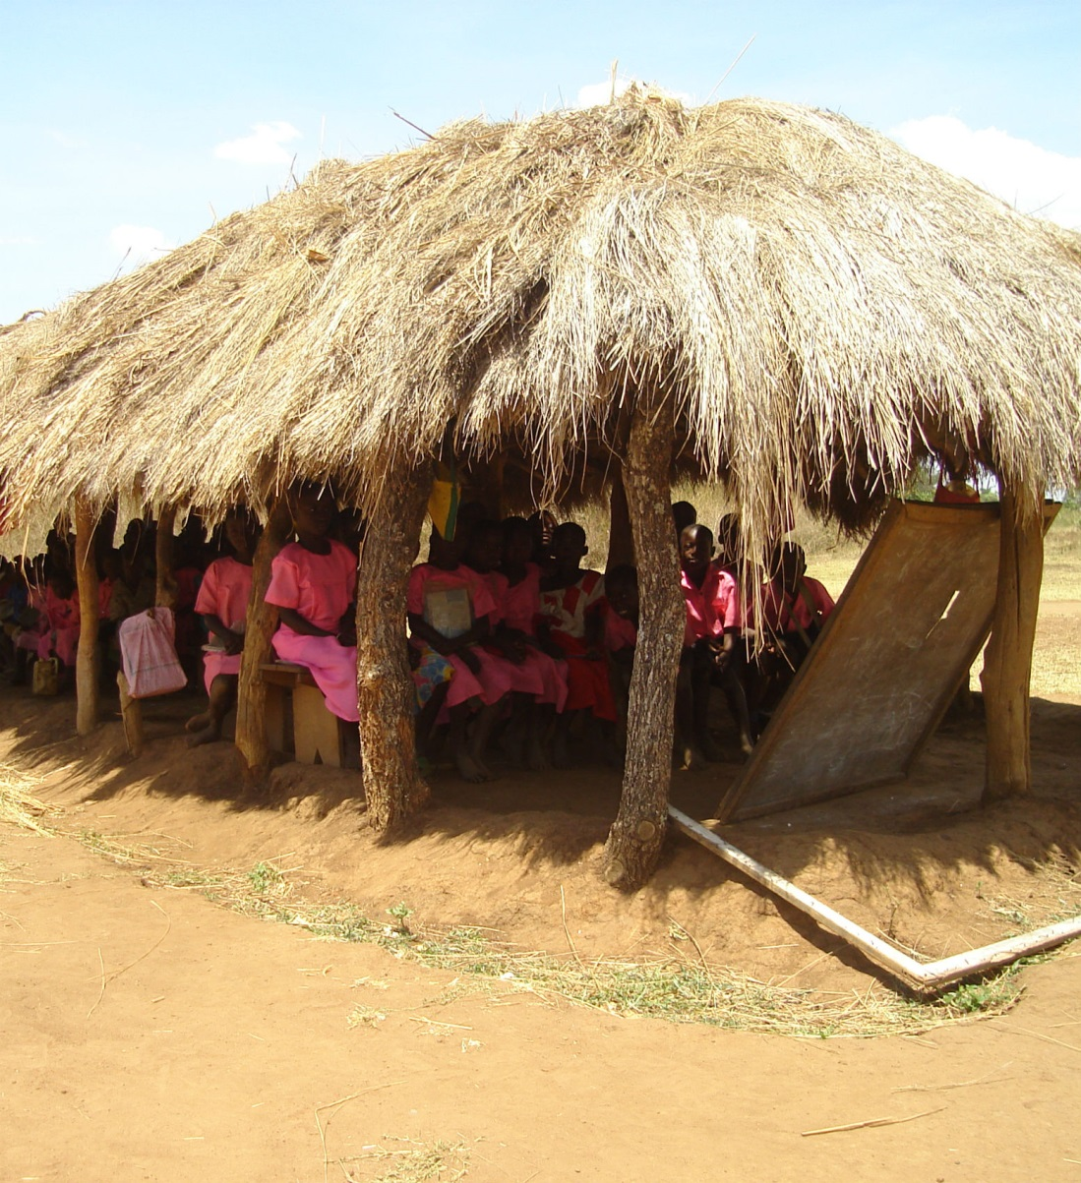
Compare UK and Kenya and Uganda
Children are taught in classrooms like this.
build-africa.org

Slide 18
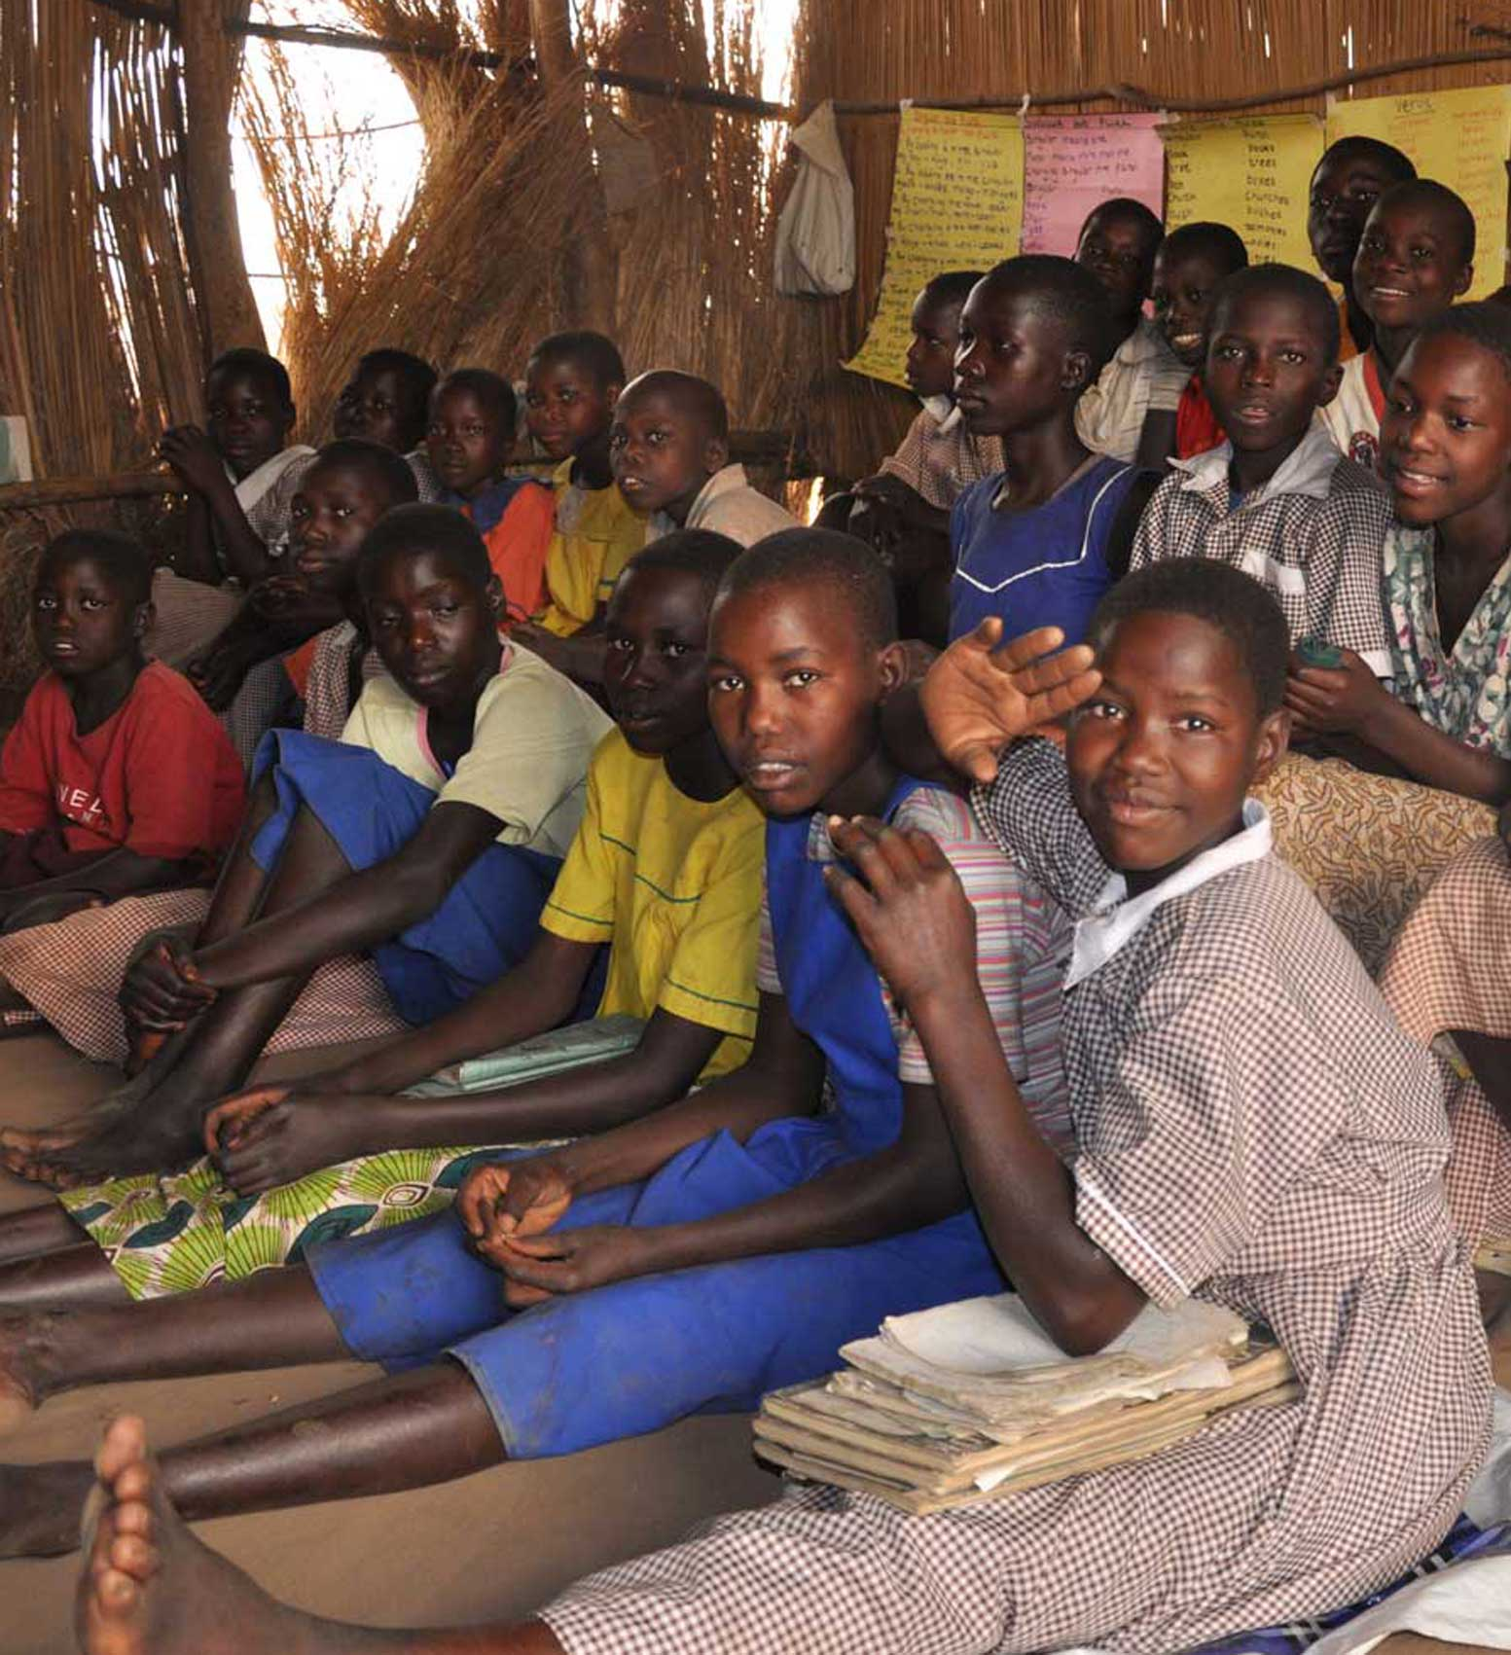
Compare UK and Kenya and Uganda
The classrooms are often overcrowded.
And children have to sit on the floor if there are not enough desks.
build-africa.org
Notes:
What can you see in this picture?
(walls made of grass reeds, conditions are overcrowded)
It doesn’t look very comfortable, does it?
Can you imagine how difficult it would be to have lessons like this?
To have children sitting comfortably at desks is a crucial component in improving the environment in which they learn.
With Government budgets overstretched in both Kenya and Uganda, there are just not enough classrooms with the space to accommodate the numbers of children needing to be off the ground and seated properly, attentive and ready to learn.

Slide 19
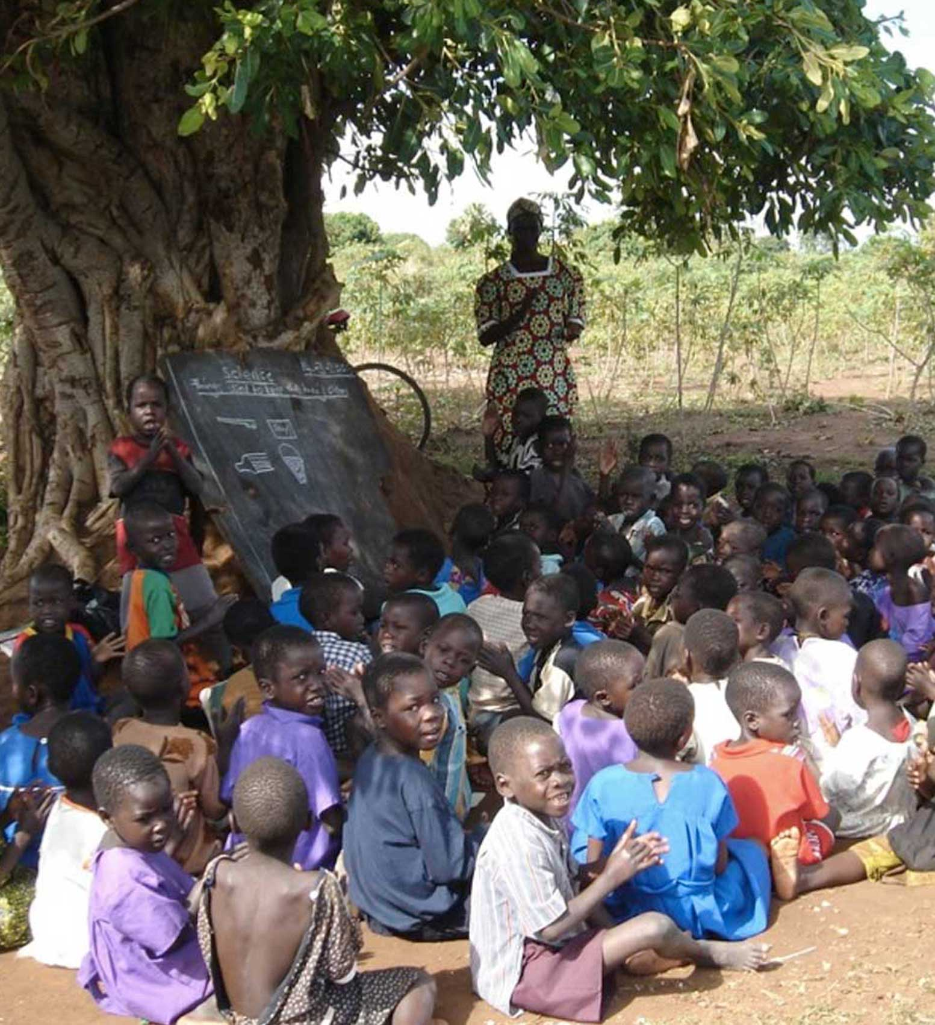
Compare UK and Kenya and Uganda
Sometimes there are no classrooms at all so the children will have lessons under a tree.
build-africa.org
Notes:
And sometimes, there are no classrooms at all!
Then the teachers have to try and teach the class under a tree where there is shade.
It may be a treat for you to have a lesson outside sometimes in the summer, but can you imagine doing it every day?
What would it be like outside every day if it was very hot?
Quite often, a lack of pre-school classrooms means that the youngest children have to study under trees or in dangerous structures.
Classes that are held outside miss an average 25% of their school days every year because when the rains come, children are simply sent home.
Not having had a quality education themselves, most parents do not know the value of education and are not involved in the education of their children. Without training the school community does not hold authorities accountable for education quality.
And a lack of knowledge and training means parents are unable to support school development or access the resources they're entitled to.

Slide 20
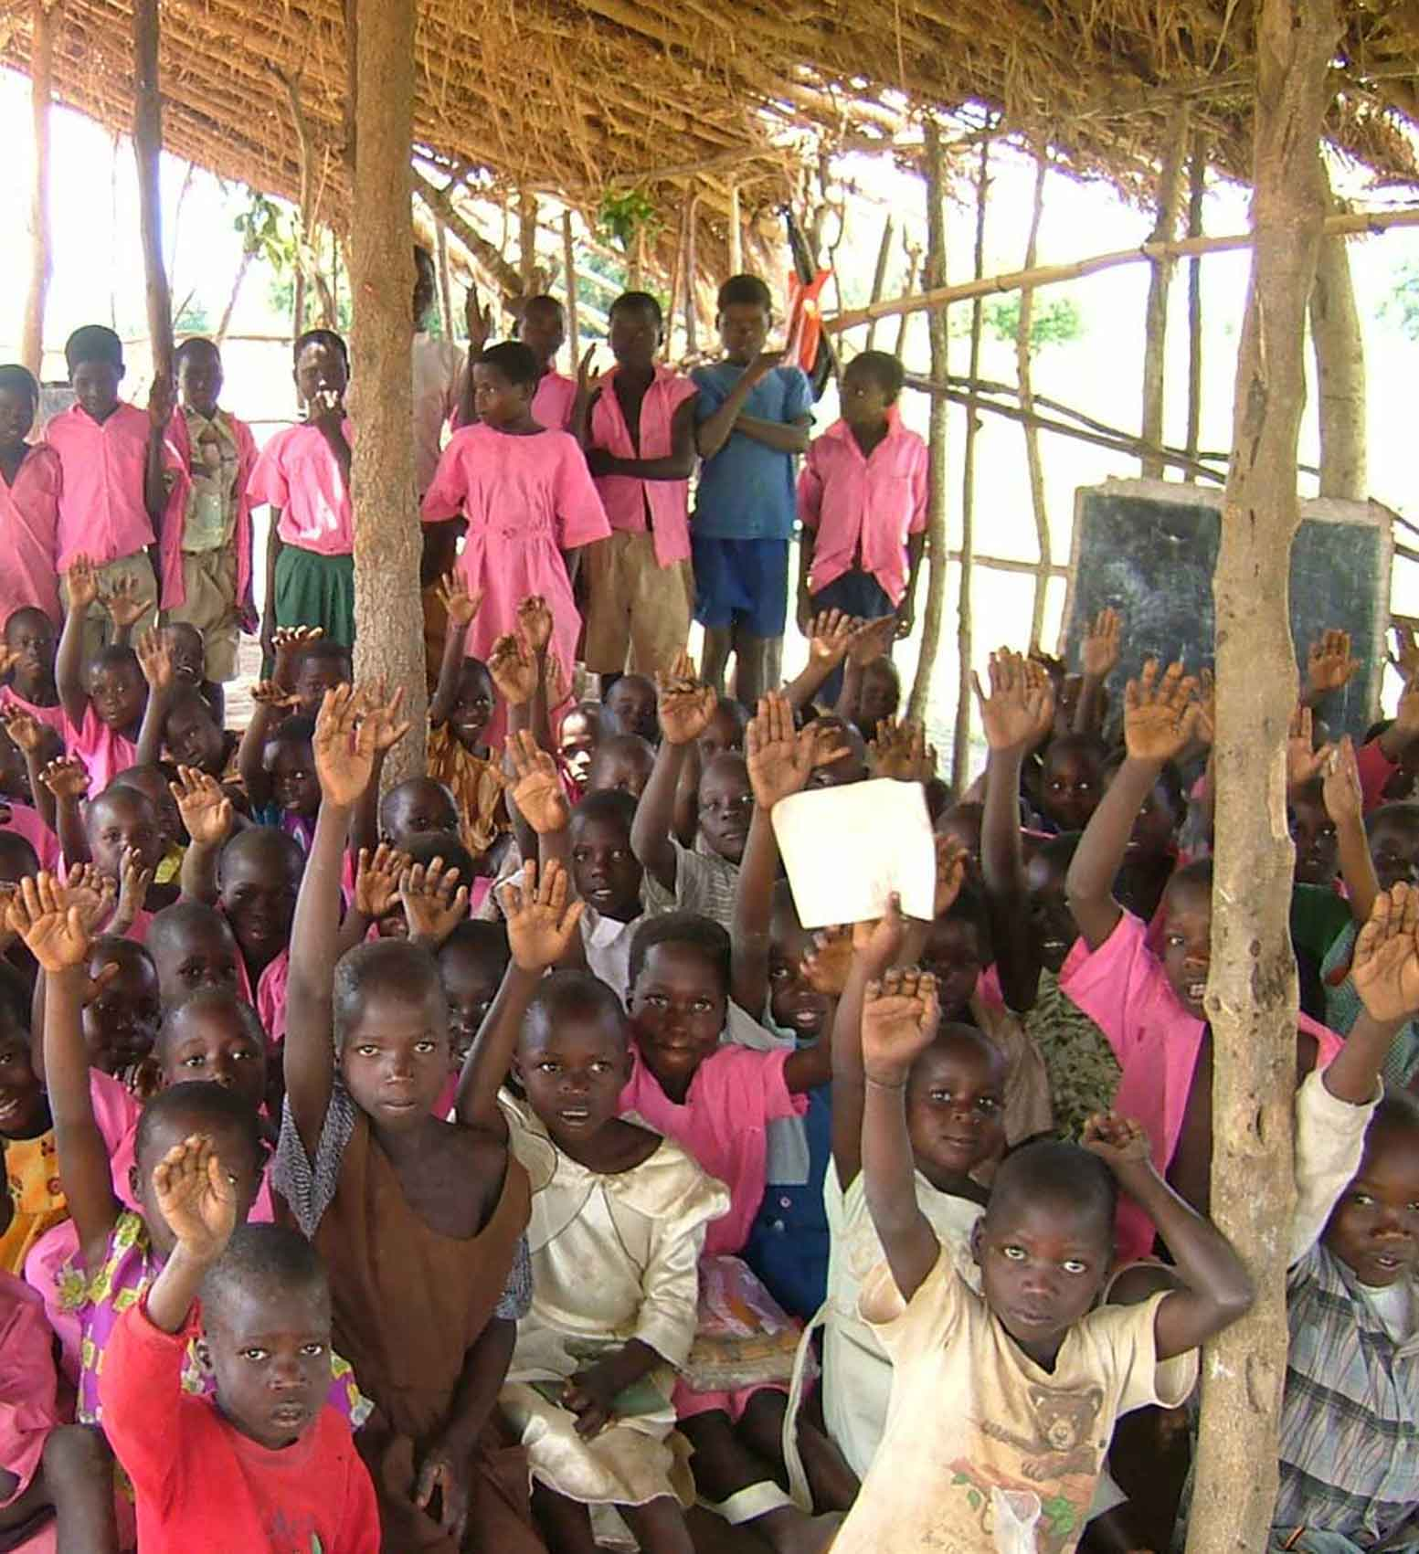
Compare UK and Kenya and Uganda
And if they do not have enough books they have to share or go without.
build-africa.org
Notes:
Some schools that Build Africa works with do not have the money to buy textbooks.
Can you imagine if you there were not enough books and you had to share with your classmates?
What would it be like if 5 or 10 of you had to share one book?
Once again inadequate Government funding means teachers are poorly trained, and a lack of refresher teacher training results in lessons being conducted using old fashioned rote learning. New teaching methods and techniques are not applied as teachers are not trained.
In poor and remote communities, and with minimal resources, teachers are isolated and do not get the opportunity to visit and learn from good schools in the region.
Pupil - teacher ratio in Kenyan primary schools : 46.78 *
(drops to 29.68 in secondary schools) *
Pupil - teacher ratio Ugandan, primary schools: 49.28 *
(drops to 17.91 in secondary schools) *
* World Data Bank 2009

Slide 21
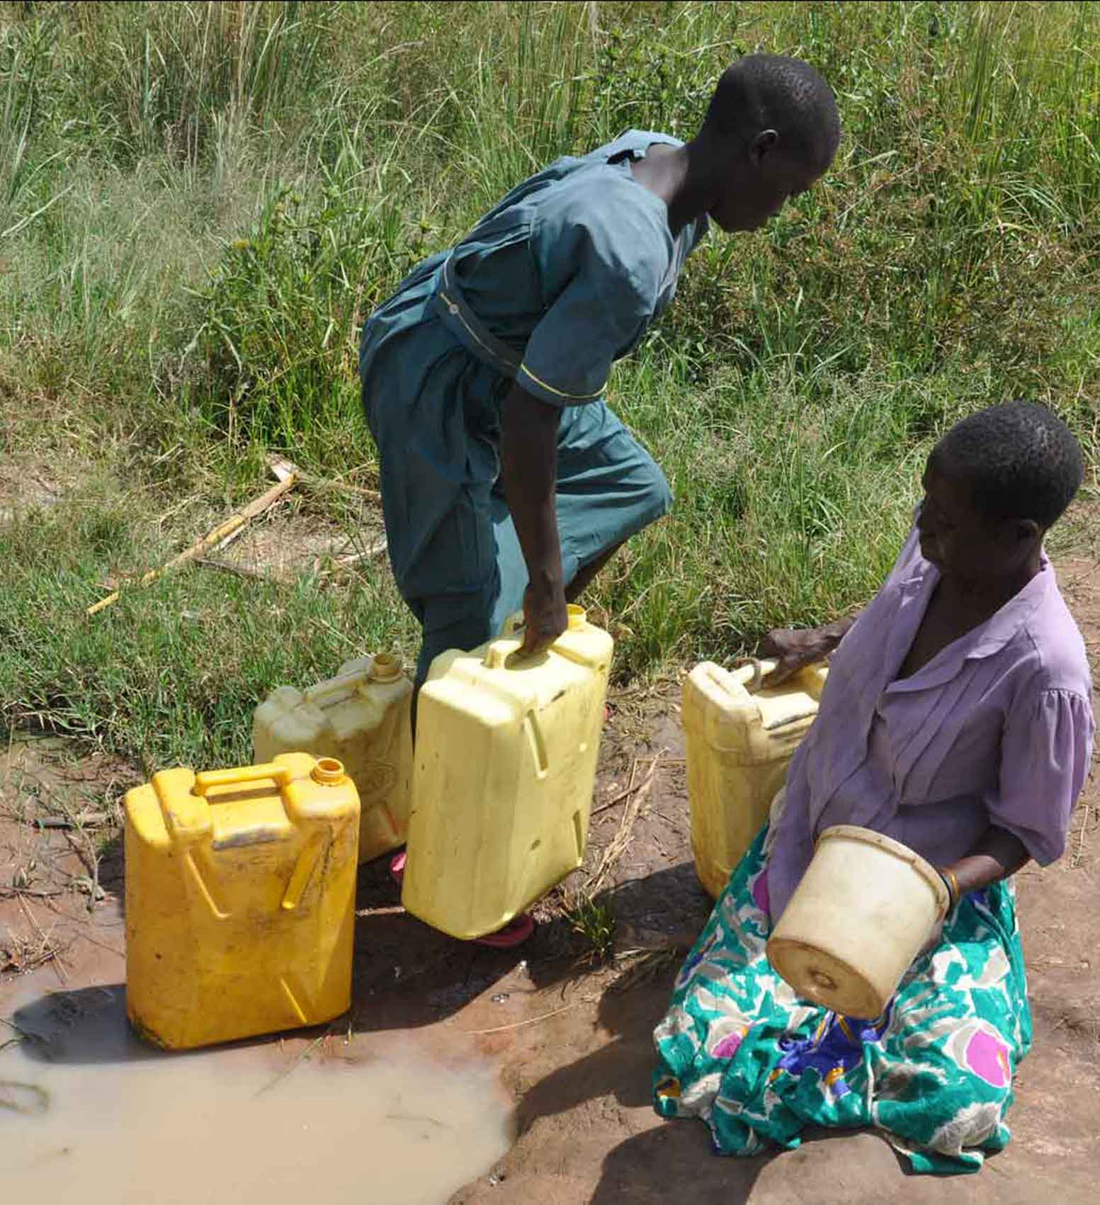
Compare UK and Kenya and Uganda
Most schools do not have drinking water, so children have to walk a long way to collect it or go without drinking water for the entire day.
Water from streams and rivers is not clean and makes everyone sick.
build-africa.org
Notes:
Poor and remote villages of Kenya and Uganda are badly affected by the lack of clean, safe water. Many people often get their water from streams and rivers that are used for drinking as well as washing, cleaning and irrigation. They are, more often than not, contaminated with excrement, making them breeding grounds for harmful bacteria and disease.
Almost half of all Africans suffer from one of six main water-borne diseases*, the most prevalent ones being diarrhoea and cholera.
Most schools do not have drinking water either, meaning pupils have to walk long distances to collect it or lack drinking water for the entire day.
An estimated 50,000 defective water supply installations exist in Africa. Examples of poorly maintained, dilapidated water infrastructures contaminated with soil and faeces bringing disease to rural communities are common.
This situation occurs because donors, governments and NGOs build water points without engaging the community in discussion or investigating the cost of keeping boreholes clean and functioning in the long term. Once constructed, boreholes fall into disrepair because the local community is unable to afford the maintenance costs. If the community has the skills to undertake the repair, spare parts are often not easily available and an external mechanic is too expensive.
* Africa Water Vision 2025

Slide 22
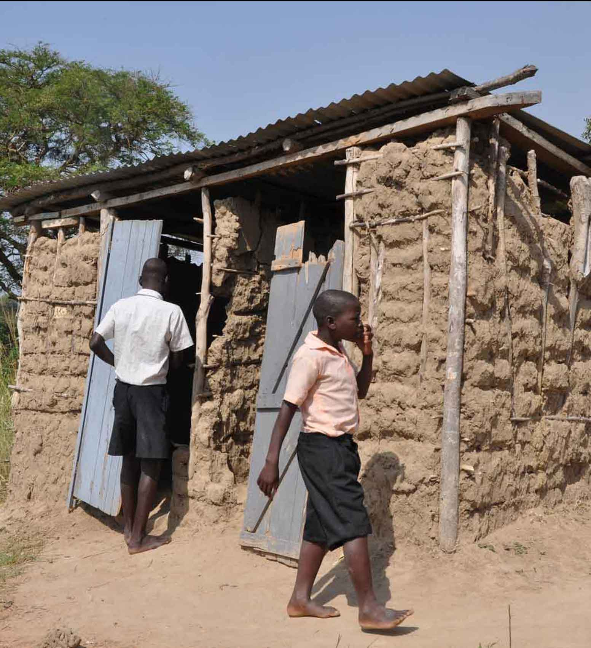
Compare UK and Kenya and Uganda
Toilets at many of the schools are very poor.
In some schools there are no toilet facilities at all which means many children are forced to use the bush.
build-africa.org
Notes:
Most of the sanitation facilities at the schools we support are extremely poor and there are frequently no separate toilets for boys and girls. Typically, there are as many as 99 children per latrine stance, far exceeding even the national recommended average of 16:1.
Existing facilities are dilapidated, unsafe and unhygienic. Many children are forced to use the bush.
Illness, due to poor sanitation, is a huge cause of absenteeism. In addition, many older girls drop out of school because poor toilet facilities mean that they do not have the privacy they require, especially at certain times of the month. Teenage girls miss on average five days of school per month due to menstruation as families are simply unable to afford sanitary protection for them.
A general lack of knowledge about health and hygiene issues contributes towards high levels of illness and children miss a lot of school, which means academic performance remains low. In Uganda, only 20% of schools have hand-washing facilities next to toilets. This means that infections and diseases spread relatively easily.

Slide 23
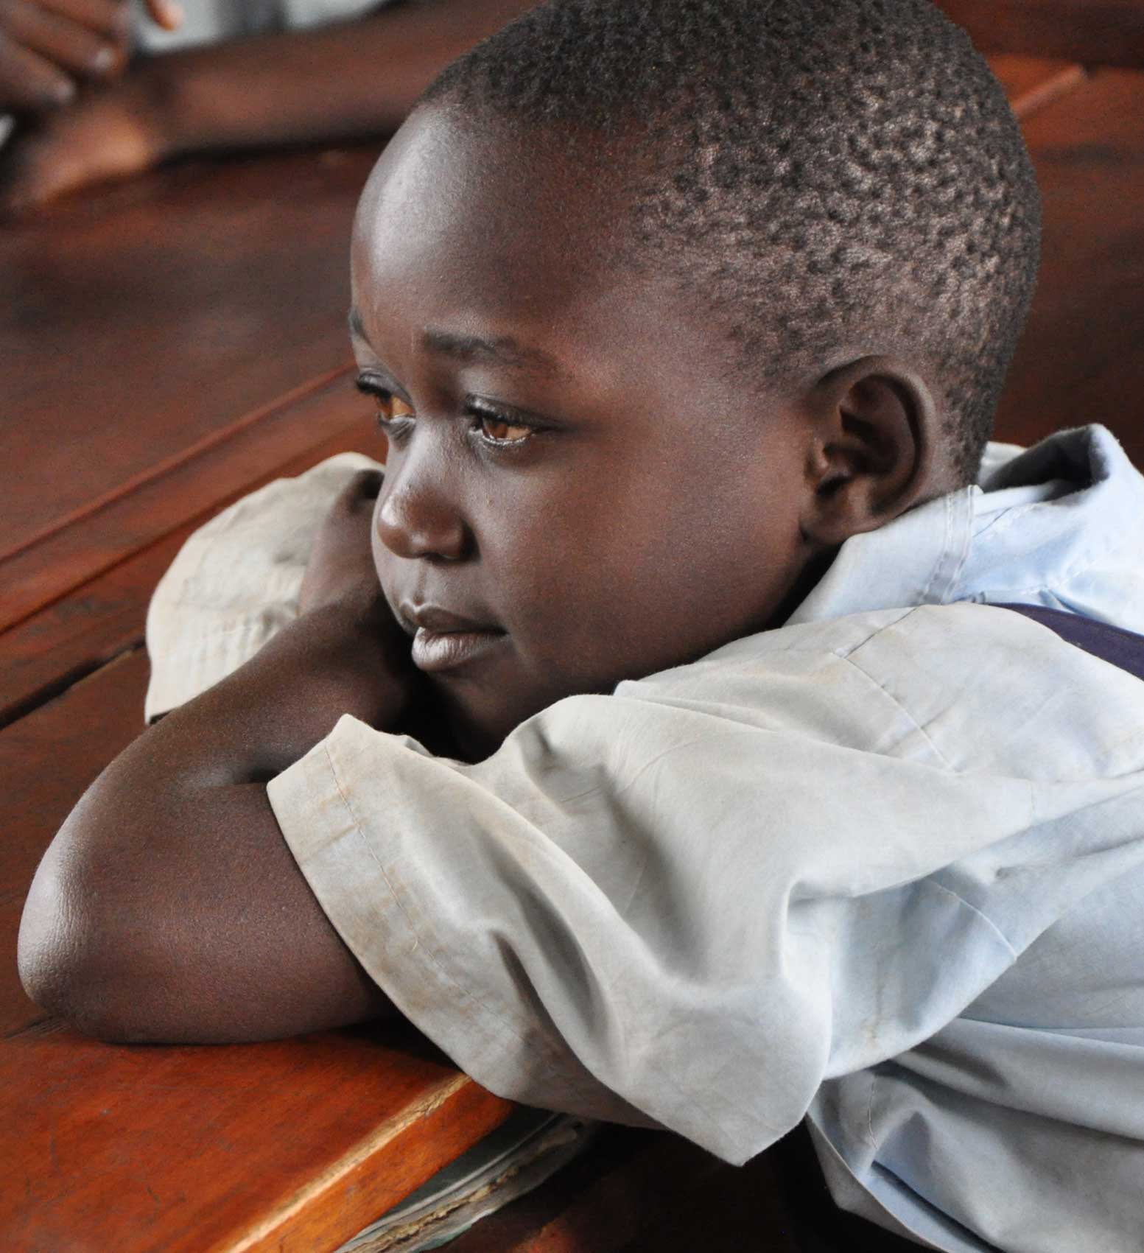
Compare UK and Kenya and Uganda
And many teachers aren’t trained properly so their lessons are repetitive and not very interesting!
build-africa.org
Notes:
Training and mentoring is vital to quality teaching, but few staff receive support beyond their basic qualification. Teachers often have to use outdated or ineffective methods that cause children’s education to suffer and lead to higher dropout rates. Poor support can also lead to a lack of motivation, meaning teachers don't show up for work or use their skills properly.

Slide 24
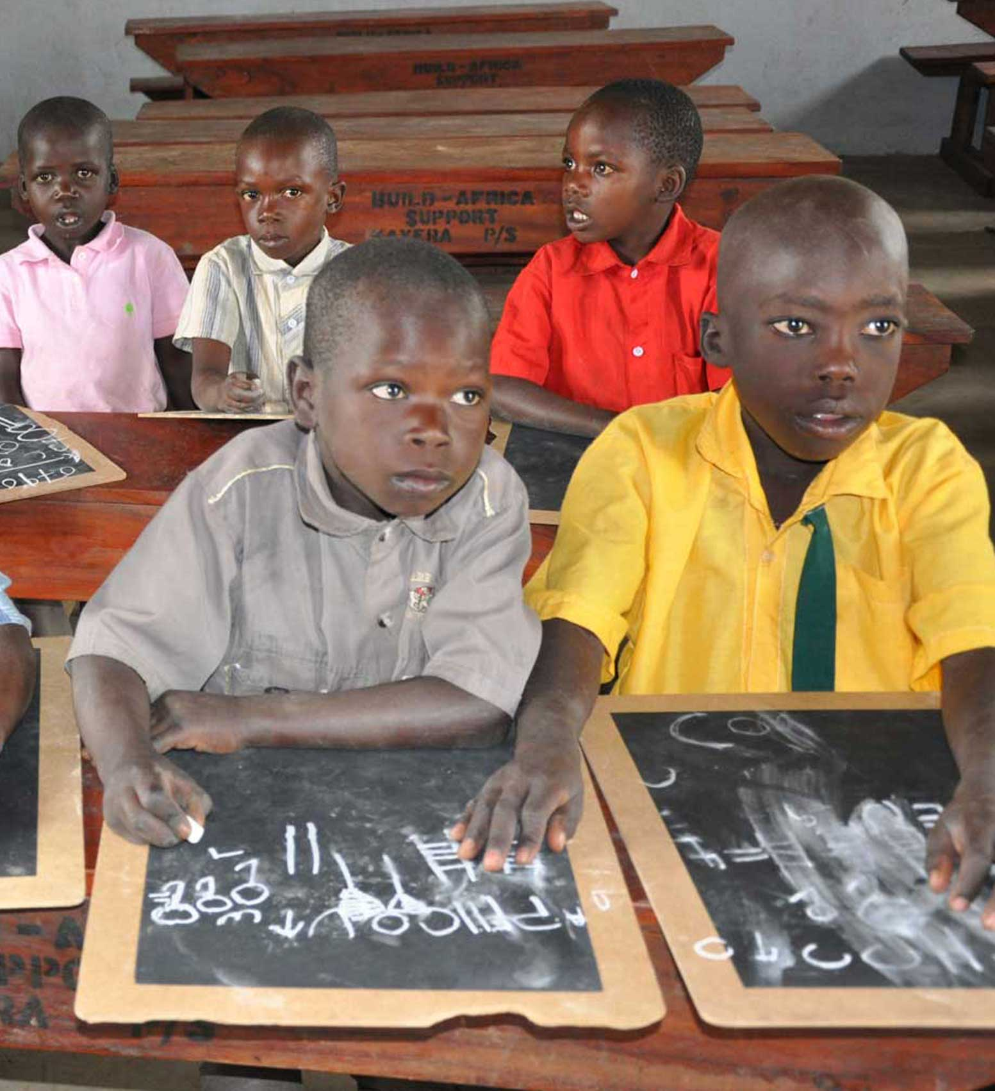
Compare UK and Kenya and Uganda
But despite these conditions children in Africa are still desperate to go to school and learn.
build-africa.org
Notes:
Even though the classrooms have got big holes in the walls and children have to sit on the floor and share textbooks, these children are still desperate to go to school and learn.
Why is it important to learn?
(Learn to read and write, learn to count and do sums, one day have a good job)

Slide 25
Why is learning hard?
Why would it be hard for children to learn at school?
Can you list some of the things that might make it difficult to learn?
build-africa.org

Slide 26
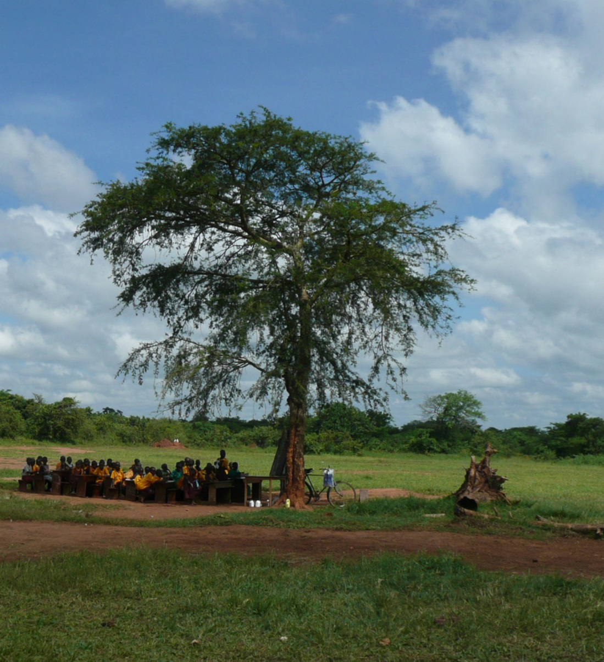
Why is learning hard?
Lessons are cancelled and students sent home when it rains.
build-africa.org
Notes:
This class is being taught outside under a tree.
It looks like a nice shady tree but what do you think happens when it rains?
Everyone has to go home!
You can’t have a lesson sitting in the rain, can you?
During the rainy season, children are often sent home so they miss lots of lessons and don’t learn as much as they should.

Slide 27
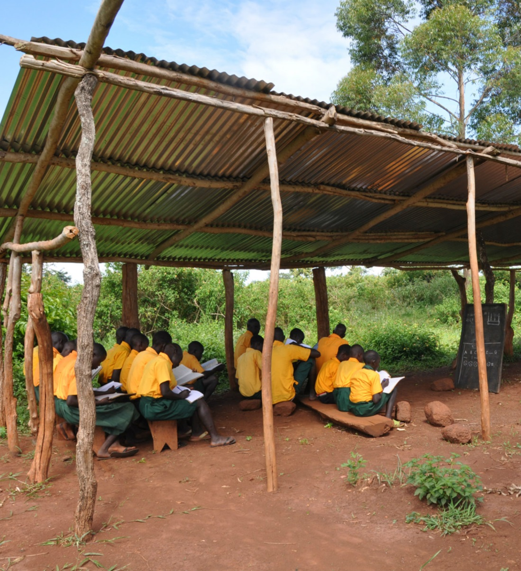
Why is learning hard?
It is hard to hear if it is windy or raining.
build-africa.org
Notes:
Look at this classroom - what would happen when it rains?
You might not able to hear the teacher talking.
You might get wet!
And when the wind is blowing?
The dust might blow in your eyes.
Your book might get blown away.
The wind might be very noisy and you can’t hear the teacher talking.

Slide 28
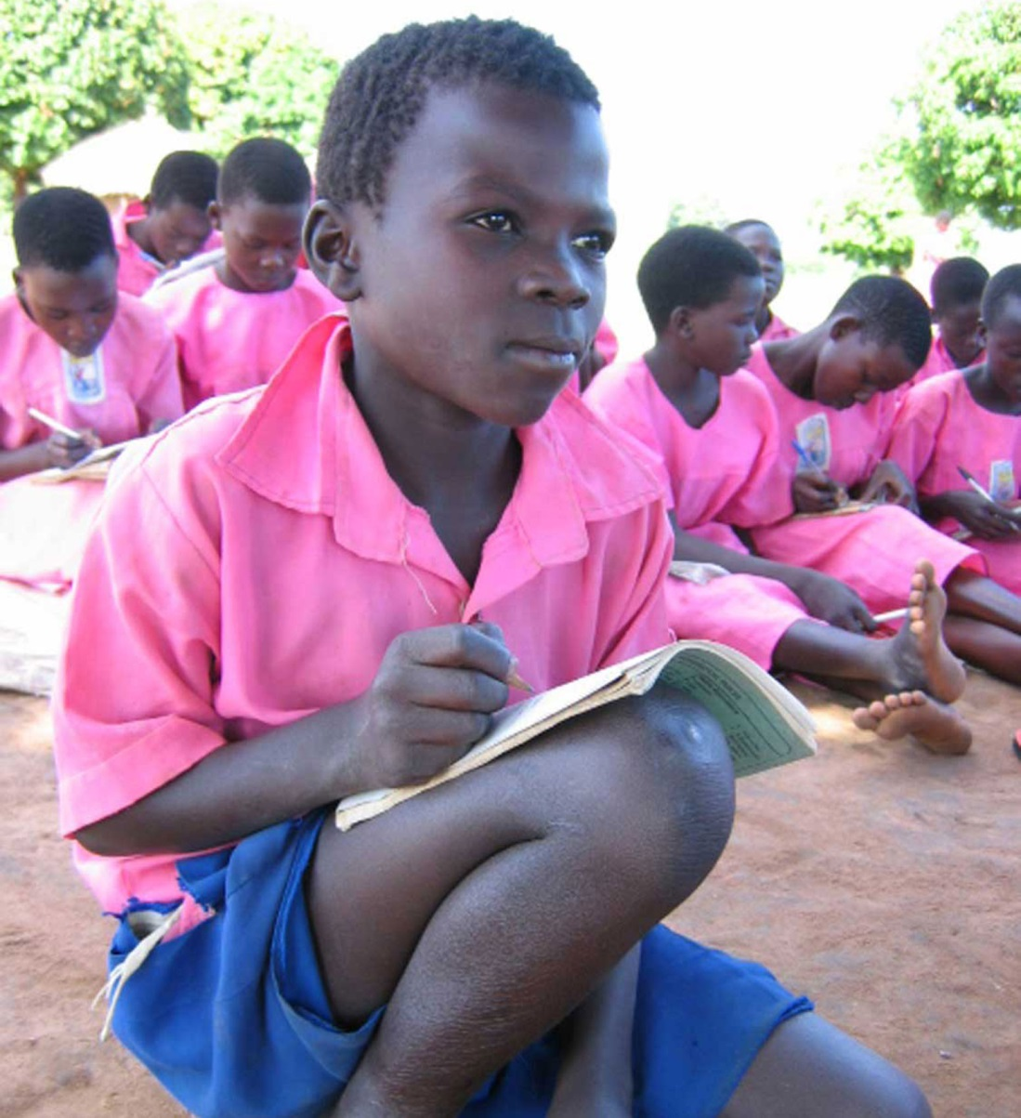
Why is learning hard?
It is hard to concentrate if you don’t have a desk and a chair to sit on.
build-africa.org
Notes:
What about if you didn’t have a desk and you wanted to concentrate when the teacher is talking?
It doesn’t look very easy to sit on the floor and have your book on your knee, does it?
Do you think it will be easy to learn if you were this little boy?
Many children at the schools we work with have no choice but to sit on the ground or the dusty floor because there are not enough desks – or simply none at all.
The lack of desks means children sit uncomfortably on the ground making concentration and writing difficult and uniforms very dirty.
In these conditions pupils are ill-prepared for exams.

Slide 29
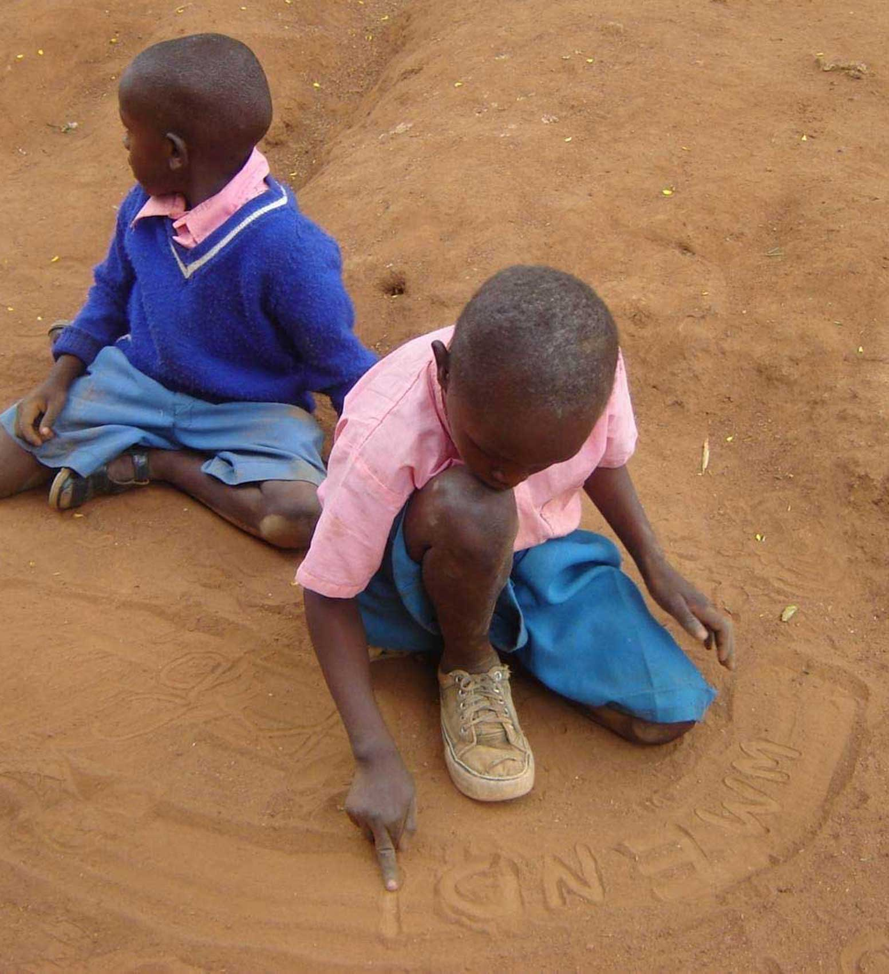
Why is learning hard?
You can’t practice writing if you don’t have any exercise books and pencils and pens.
build-africa.org
Notes:
And if you don’t have books or pencils to practice your writing, how will you learn to write?
A lot of the younger classes do not have books. They have to practice their letters in the sand at their school.
Good teachers require adequate teaching materials in order to deliver their message effectively to their pupils.
A lack of learning aids has a direct impact on the quality of education children are receiving.
And the lack of text books means many children are unable to follow lessons.

Slide 30
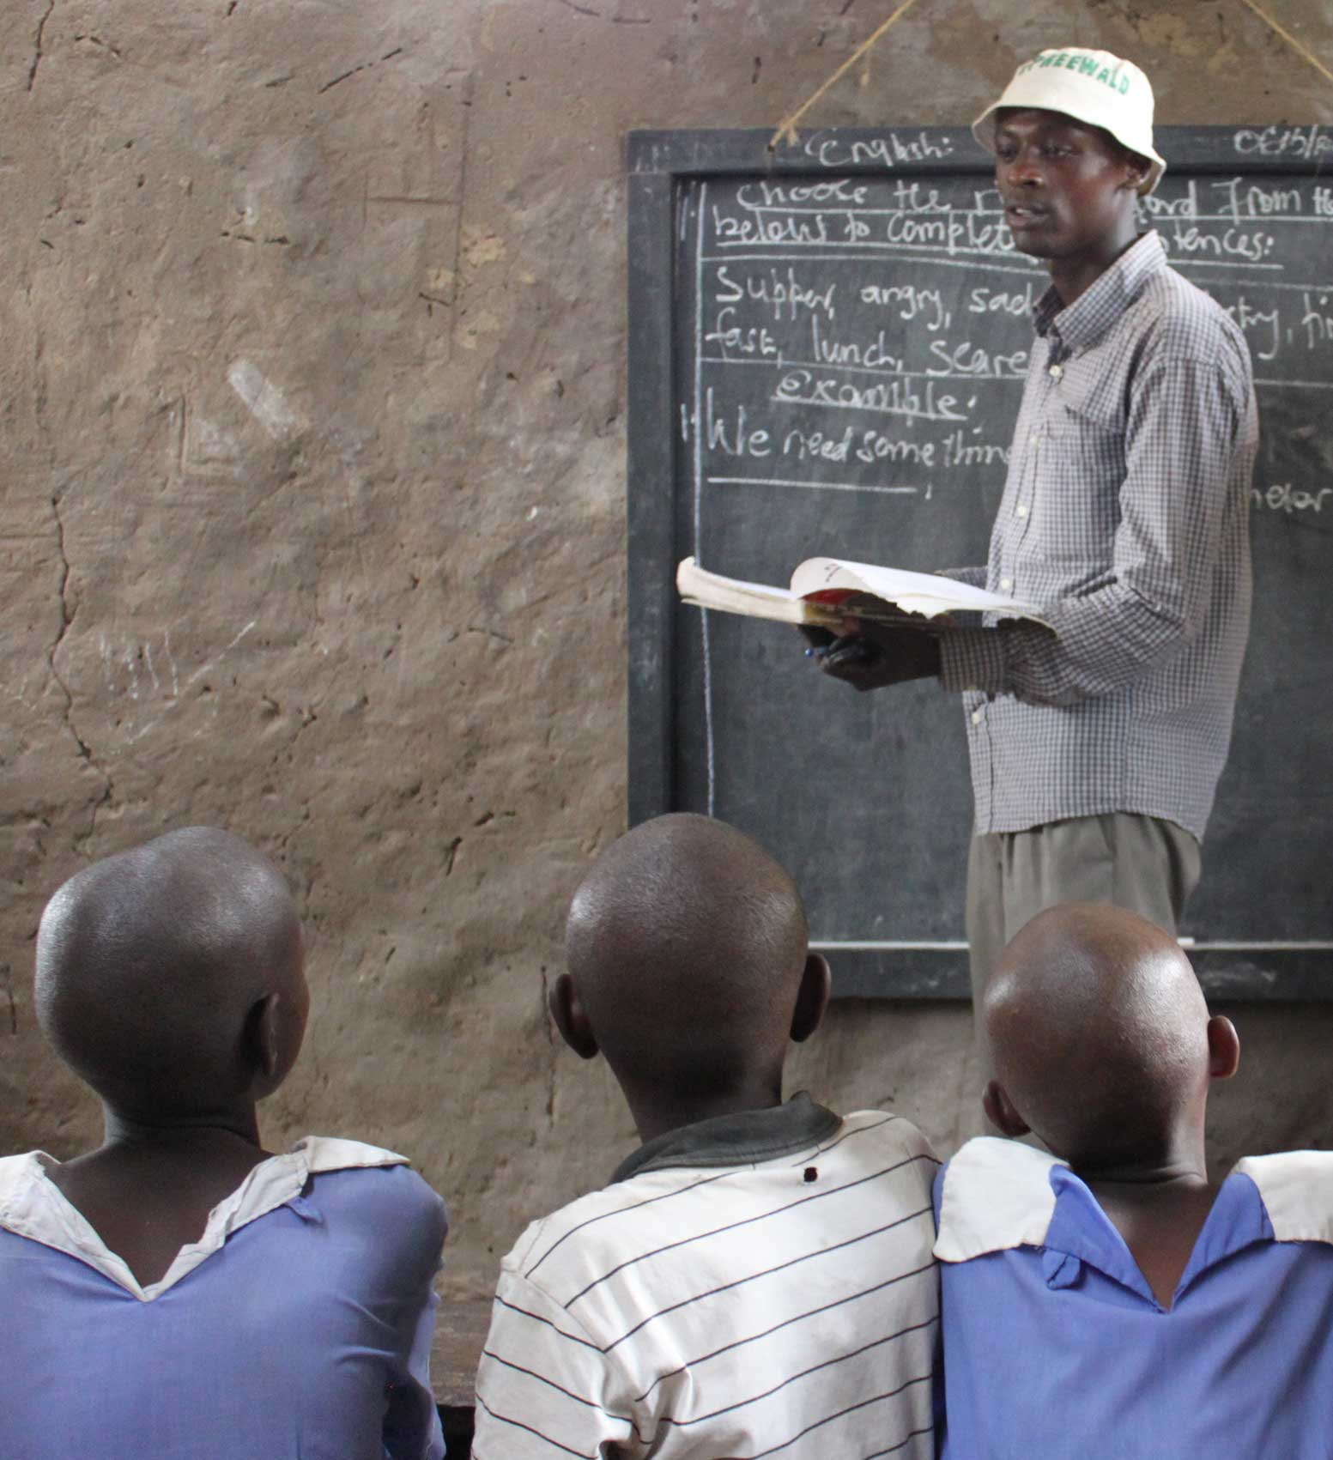
Why is learning hard?
It’s hard to remember your lessons if you’re bored and don’t understand what the teacher is trying to tell you.
It’s even harder to learn when your teacher isn’t even there!
build-africa.org
Notes:
Imagine if your teacher asked you to repeat numbers and letters over and over again. That wouldn’t be very interesting!
Sometimes the teachers don’t even turn up to school as they live such a long way away.
It’s important that teachers live close by and get good training and support from the school so they can deliver exciting lessons.

Slide 31
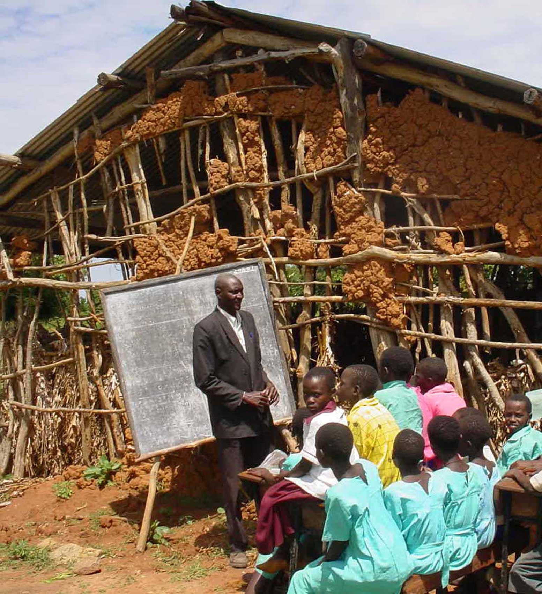
Why is learning hard?
The combination of these issues results in 3 out of 4 pupils dropping out before completing primary school and only 20% achieving recommended competency levels in literacy and numeracy.
build-africa.org
Notes:
In Kenya 78% of the adult population (people over age of 15) can read and write – this is much lower in rural areas.
In Uganda 73.8% of the adult population (people over age of 15) can read and write – this is much lower in rural areas.
* World Data Bank 2015

Slide 32
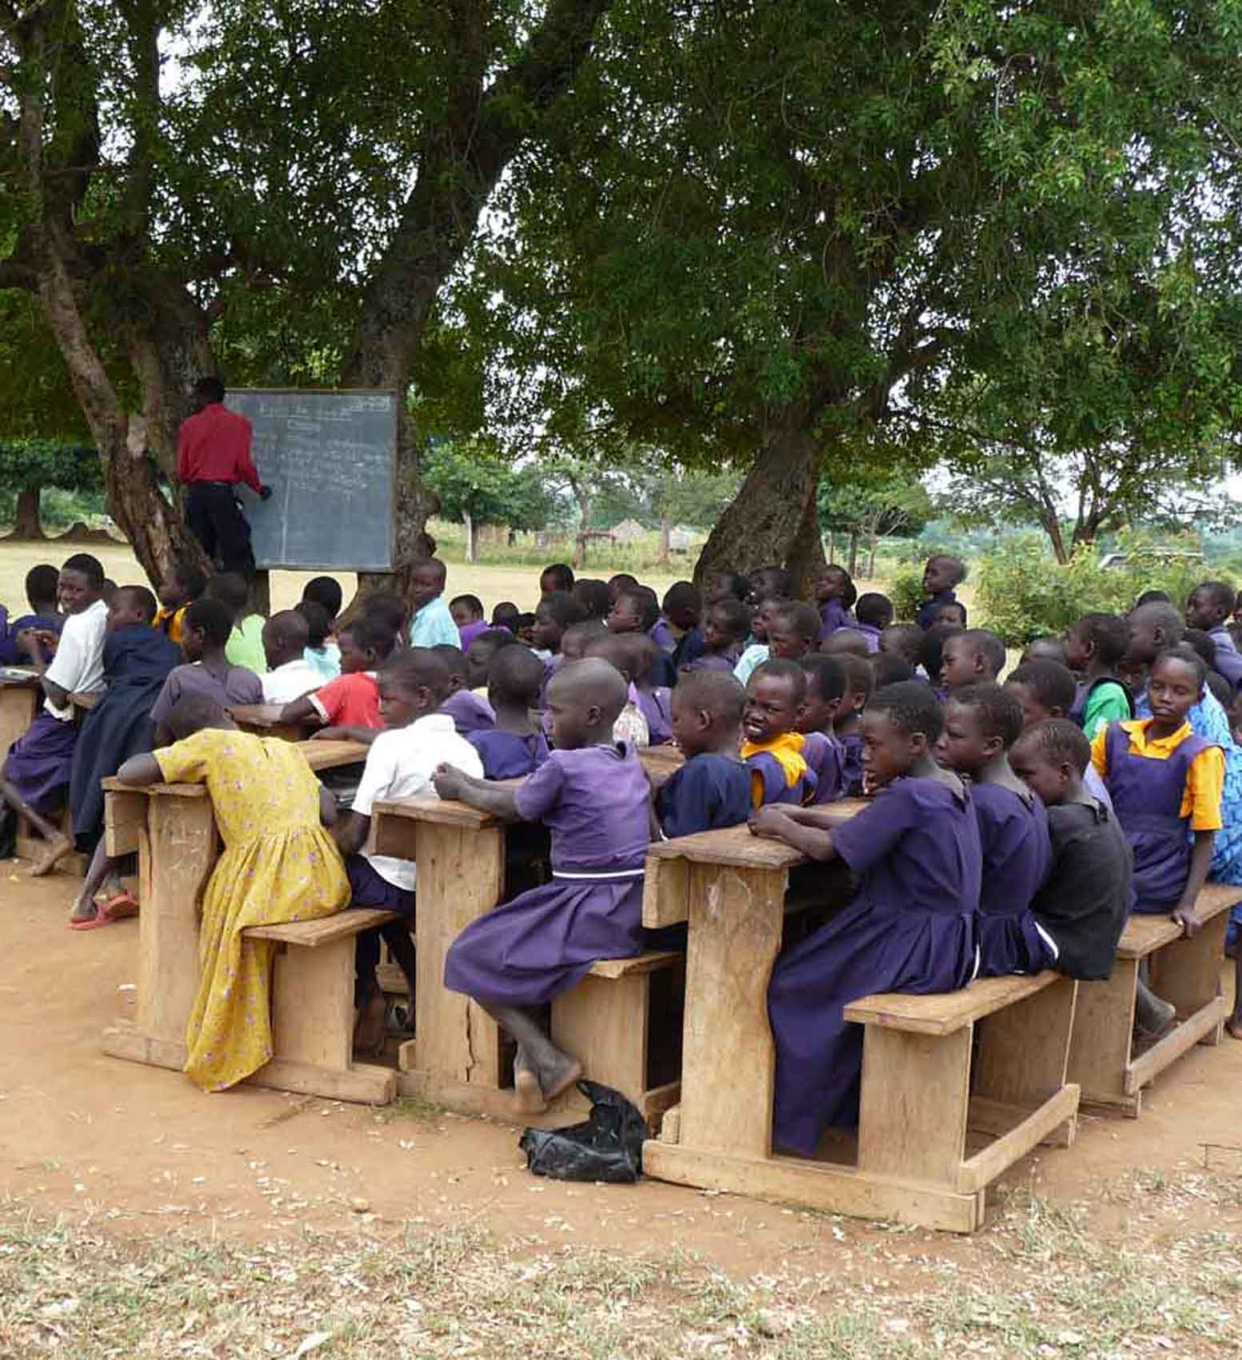
How we can make a difference
That’s why Build Africa needs your help.
We want to work with schools in Kenya and Uganda to make it easier for children to learn, so they can have a good future.
build-africa.org
Notes:
We want to ensure that rural children receive a quality education in a safe and secure environment that provides them with the knowledge, skills and competencies to continue to learn, grow into healthy adults and lead safe and productive lives.
Not only does Build Africa ensure that schools are built using good quality materials and adhere to government standards, but Build Africa’s involvement with a school encompasses the entire community and encourages empowerment and ownership by both students and parents for a long time to come.
By supporting a school for at least 7 years, and monitoring it until it is financially self-sufficient, Build Africa can give the school the best possible chance that once the opportunity of education has been provided, it is not taken away.

Slide 33
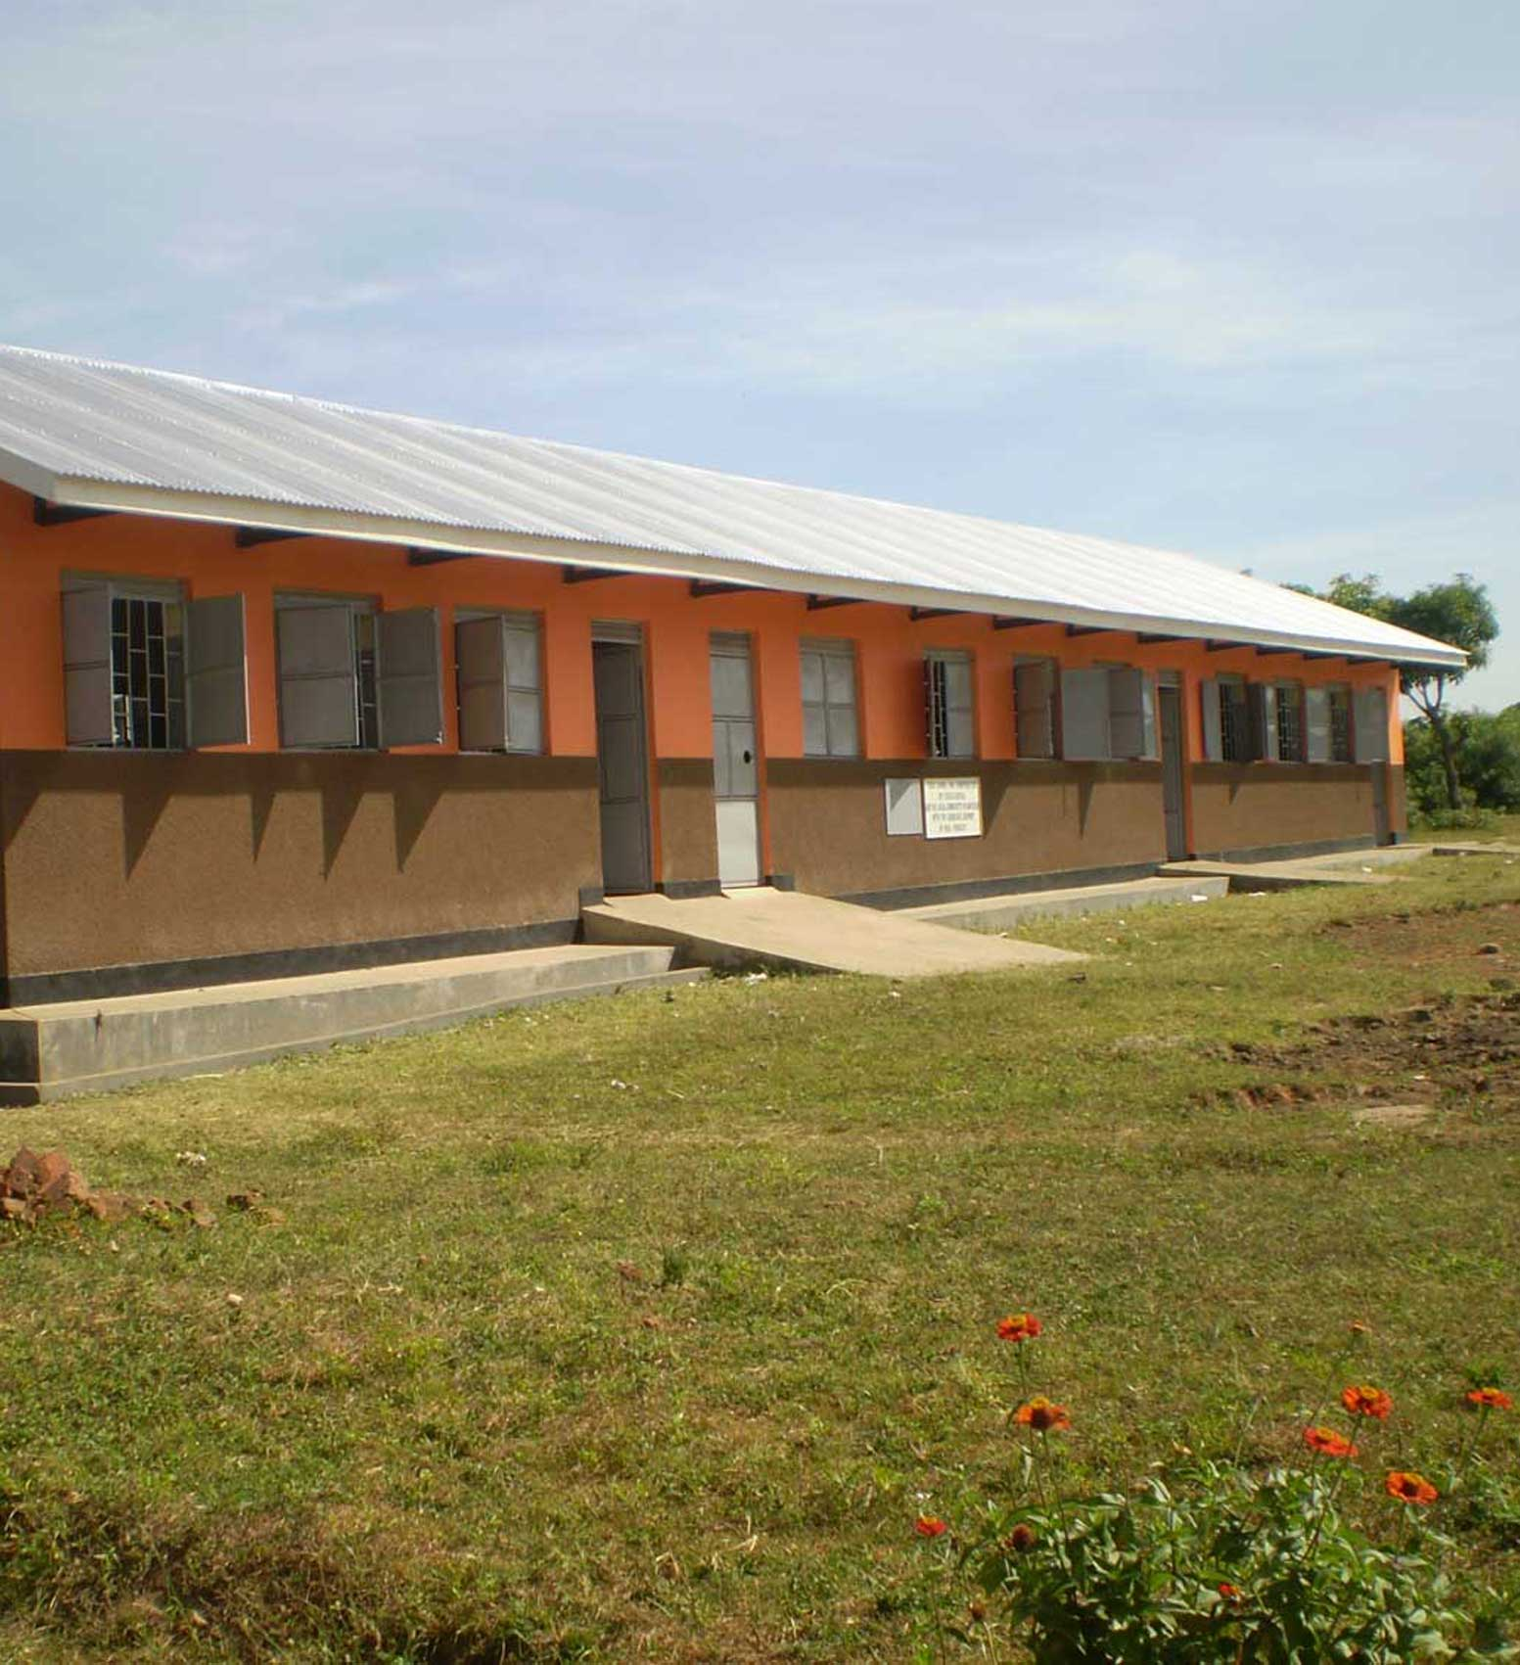
How we can make a difference
Build Africa wants to build safe classrooms
build-africa.org
Notes:
We ensuing that schools are safe, healthy and well equipped, and that every child gets the chance to learn. We aim to help children have the best possible education during their time at school in a safe and engaging environment.

Slide 34
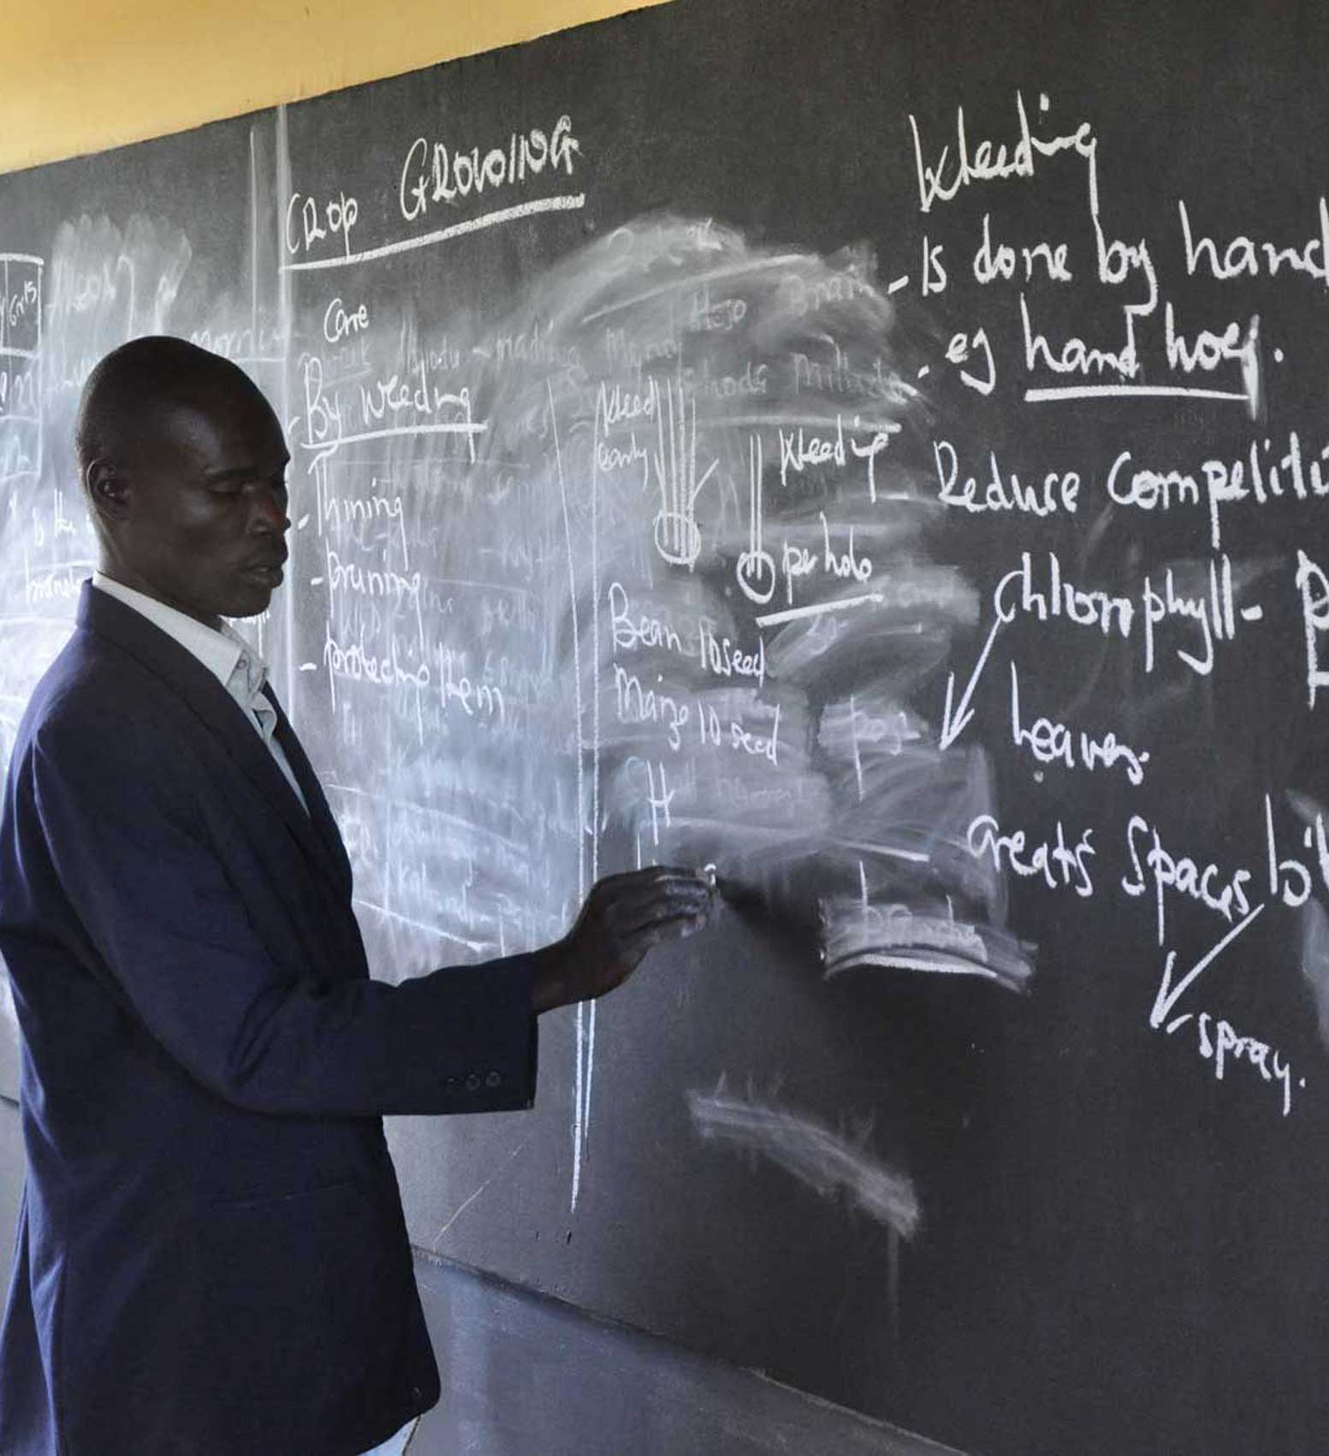
How we can make a difference
So that children can learn properly…
build-africa.org
Notes:
Inside the classrooms are light and there is a nice big blackboard

Slide 35
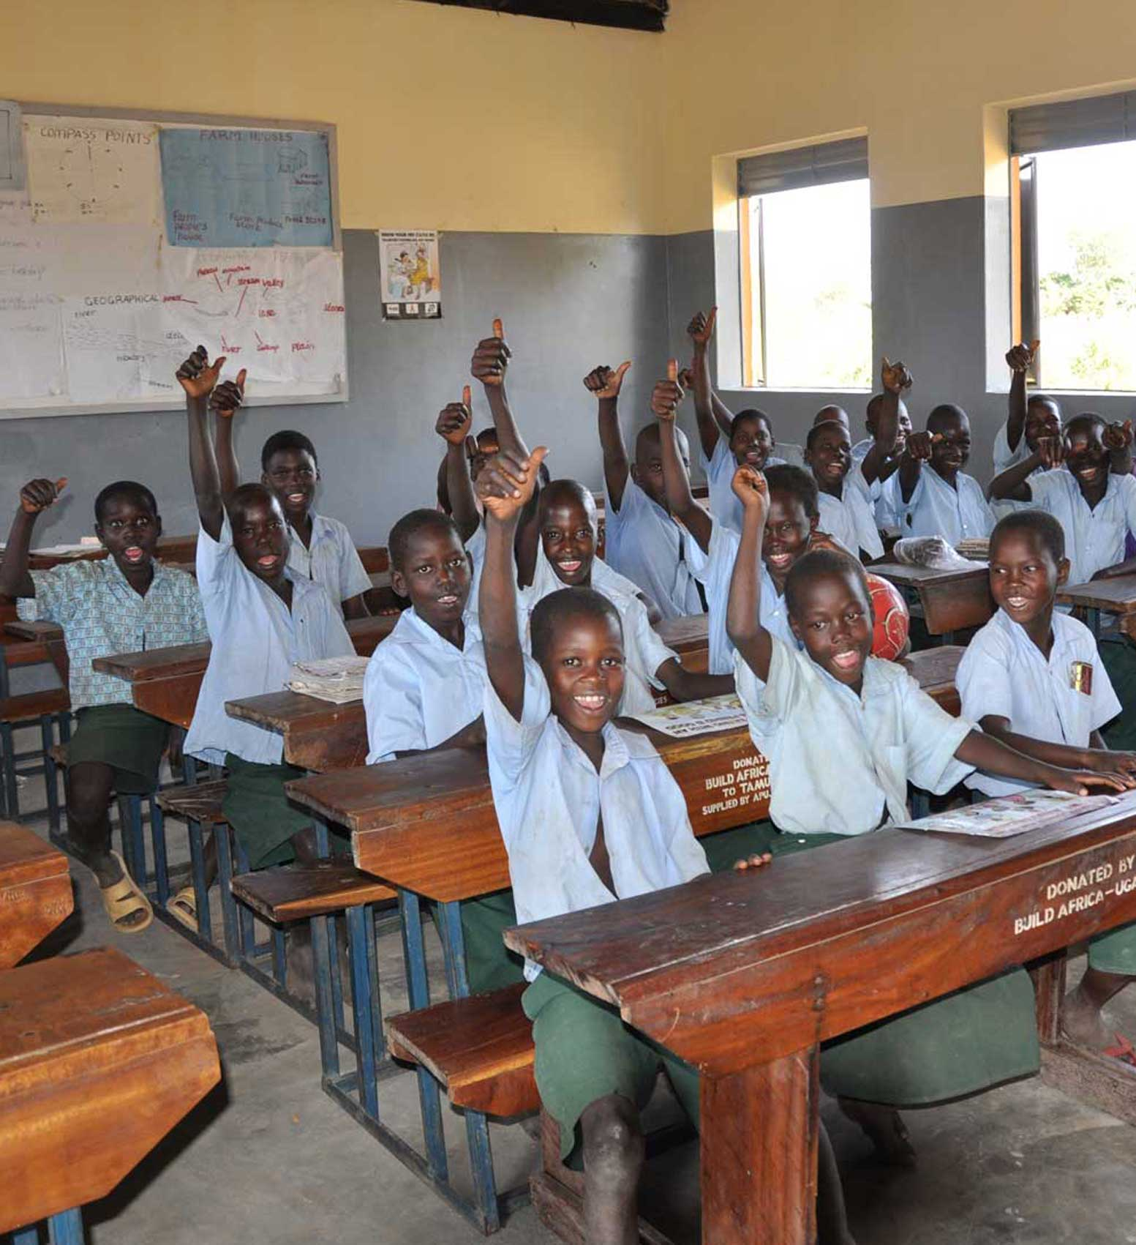
How we can make a difference
…sitting at their own desks…
build-africa.org
Notes:
Build Africa wants to buy desks for the classrooms at the schools in Kenya and Uganda.
So that the children do not have to sit on the floor.

Slide 36
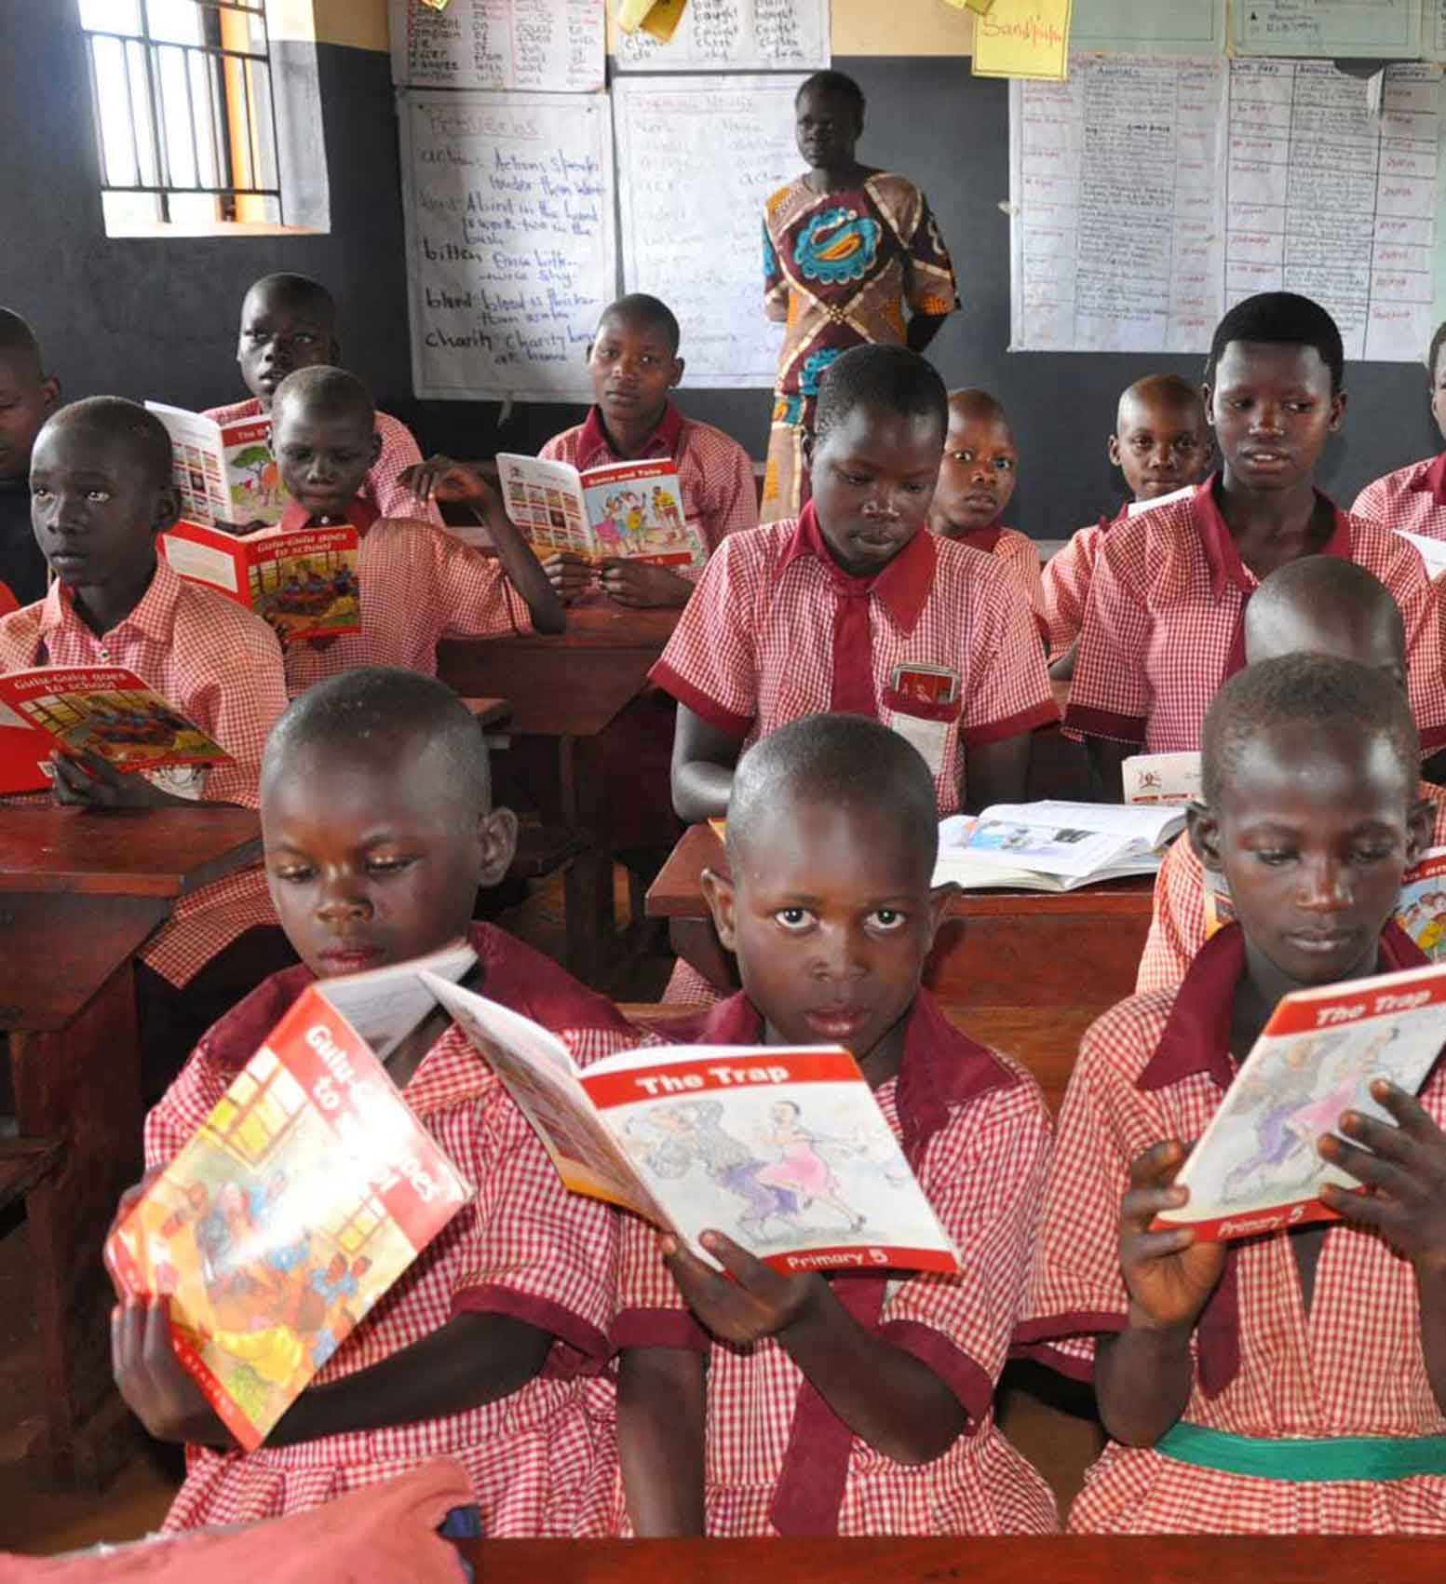
How we can make a difference
…with enough textbooks so that they do not have to share…
build-africa.org
Notes:
And Build Africa wants to buy lots of textbooks so each child will have their own textbook and they won’t have to share.

Slide 37
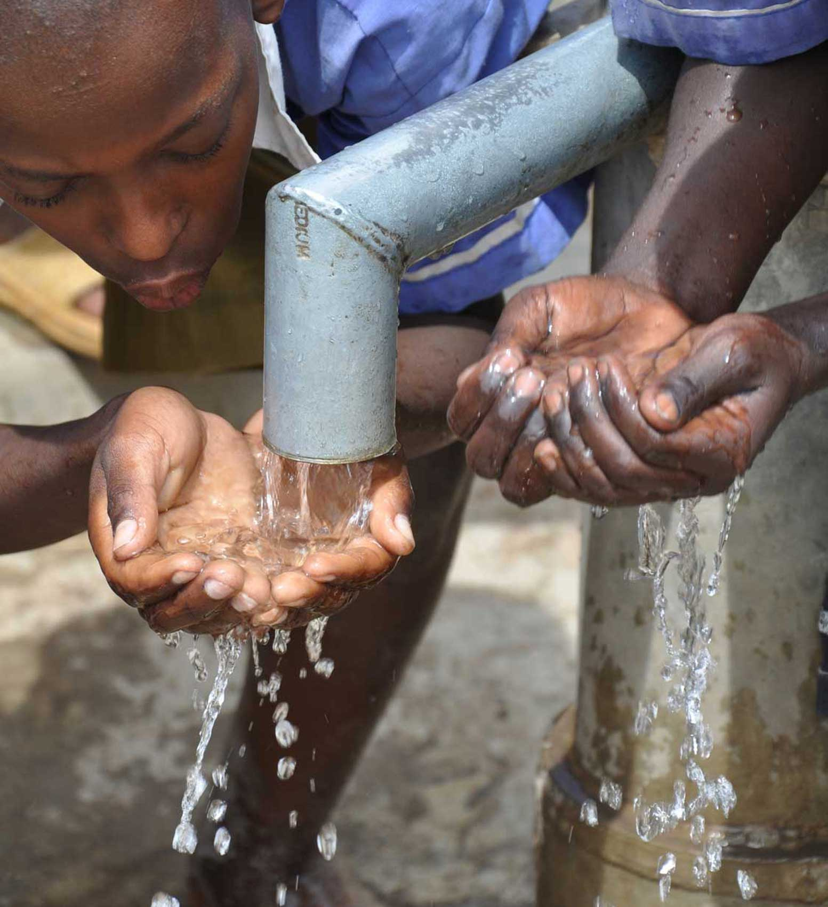
How we can make a difference
…with clean, safe water to drink.
build-africa.org
Notes:
All of the efforts of the children, teachers and parents are undermined because their fundamental right to clean and safe drinking water is not being fulfilled.
A borehole change everything, helping children to avoid diseases, and in the long run, stay in school and complete their education
Build Africa prevents water sources becoming a burden on the local community by completing a thorough assessment of the viability and sustainability of a borehole before it is installed.
Once a borehole has been built, community members are trained to maintain it and a maintenance kit is provided so that all the necessary tools are available.
A water committee is established or an existing one is developed so that the community can effectively plan how the borehole will be managed and the long term monitoring of the school is extended to the borehole ensuring this infrastructure is sustainable.
This means that any borehole constructed by Build Africa will supply rural communities with safe, clean drinking water over a sustained period of time and limit the threat of disease.

Slide 38
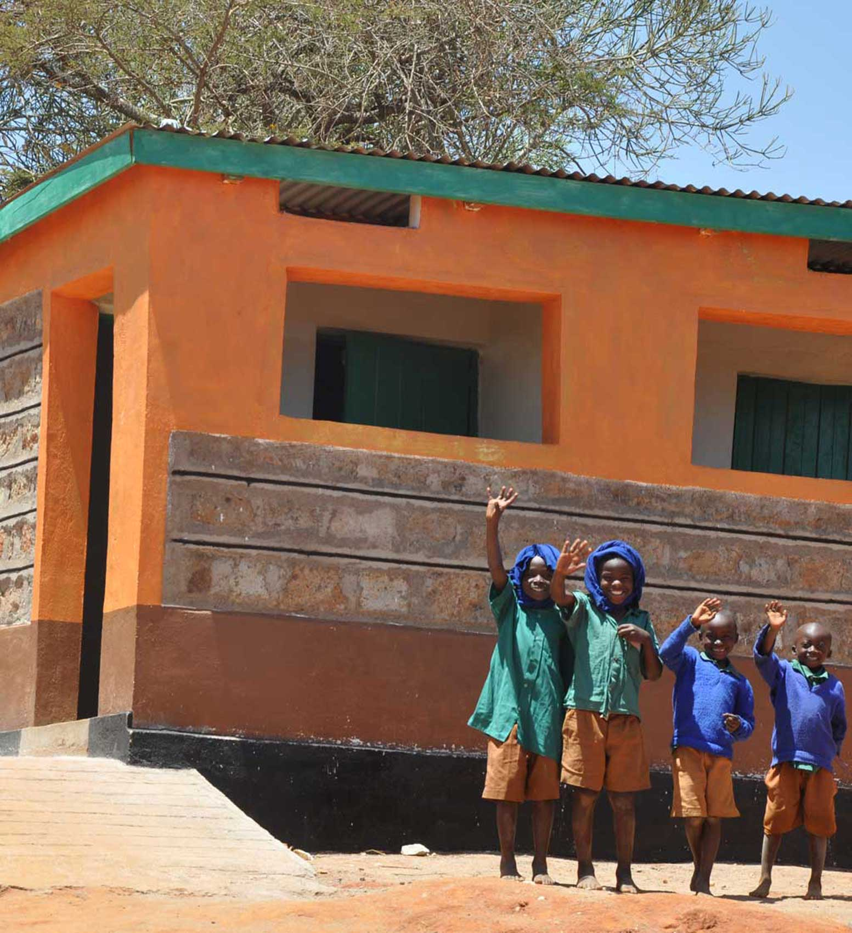
How we can make a difference
Build Africa can build new latrines for girls and boys…
build-africa.org
Notes:
There are effective and practical solutions we can implement to ensure that poor sanitation facilities do not lead to sickness and absenteeism. Both are serious threats to the chances of children receiving a quality education and therefore to their future.
We work to ensure schools have adequate toilets and appropriate hand-washing facilities.
Separate and hygienic toilet facilities will improve sanitation levels, decrease sickness and ensure that girls have the privacy they need.
A simple hand washing solution need not be expensive and we are working with schools encouraging them to place suitable facilities next to all their toilets.

Slide 39
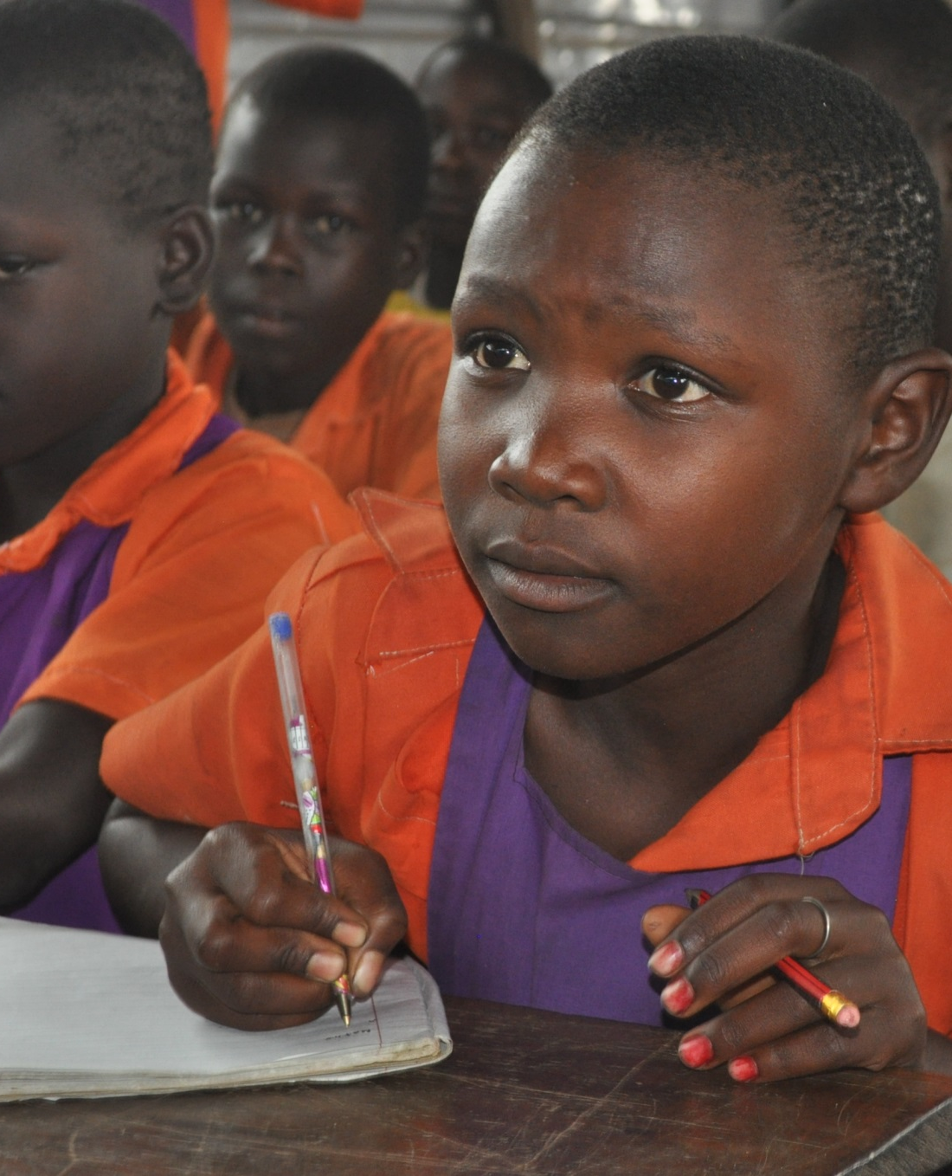
How we can make a difference
…and train teachers so they are motivated and can deliver exciting lessons.
build-africa.org
Notes:
We train teachers in child-focused teaching methods appropriate for each age group and connect them through collaborative networks to solve problems, making sure staff are motivated and well supported.
We help establish and monitor school policies and practices that promote and protect the welfare of children and teachers.
We ensure children learn important health, relationship and life skills so they have the power to make better decisions and become successful after leaving school.

Slide 40
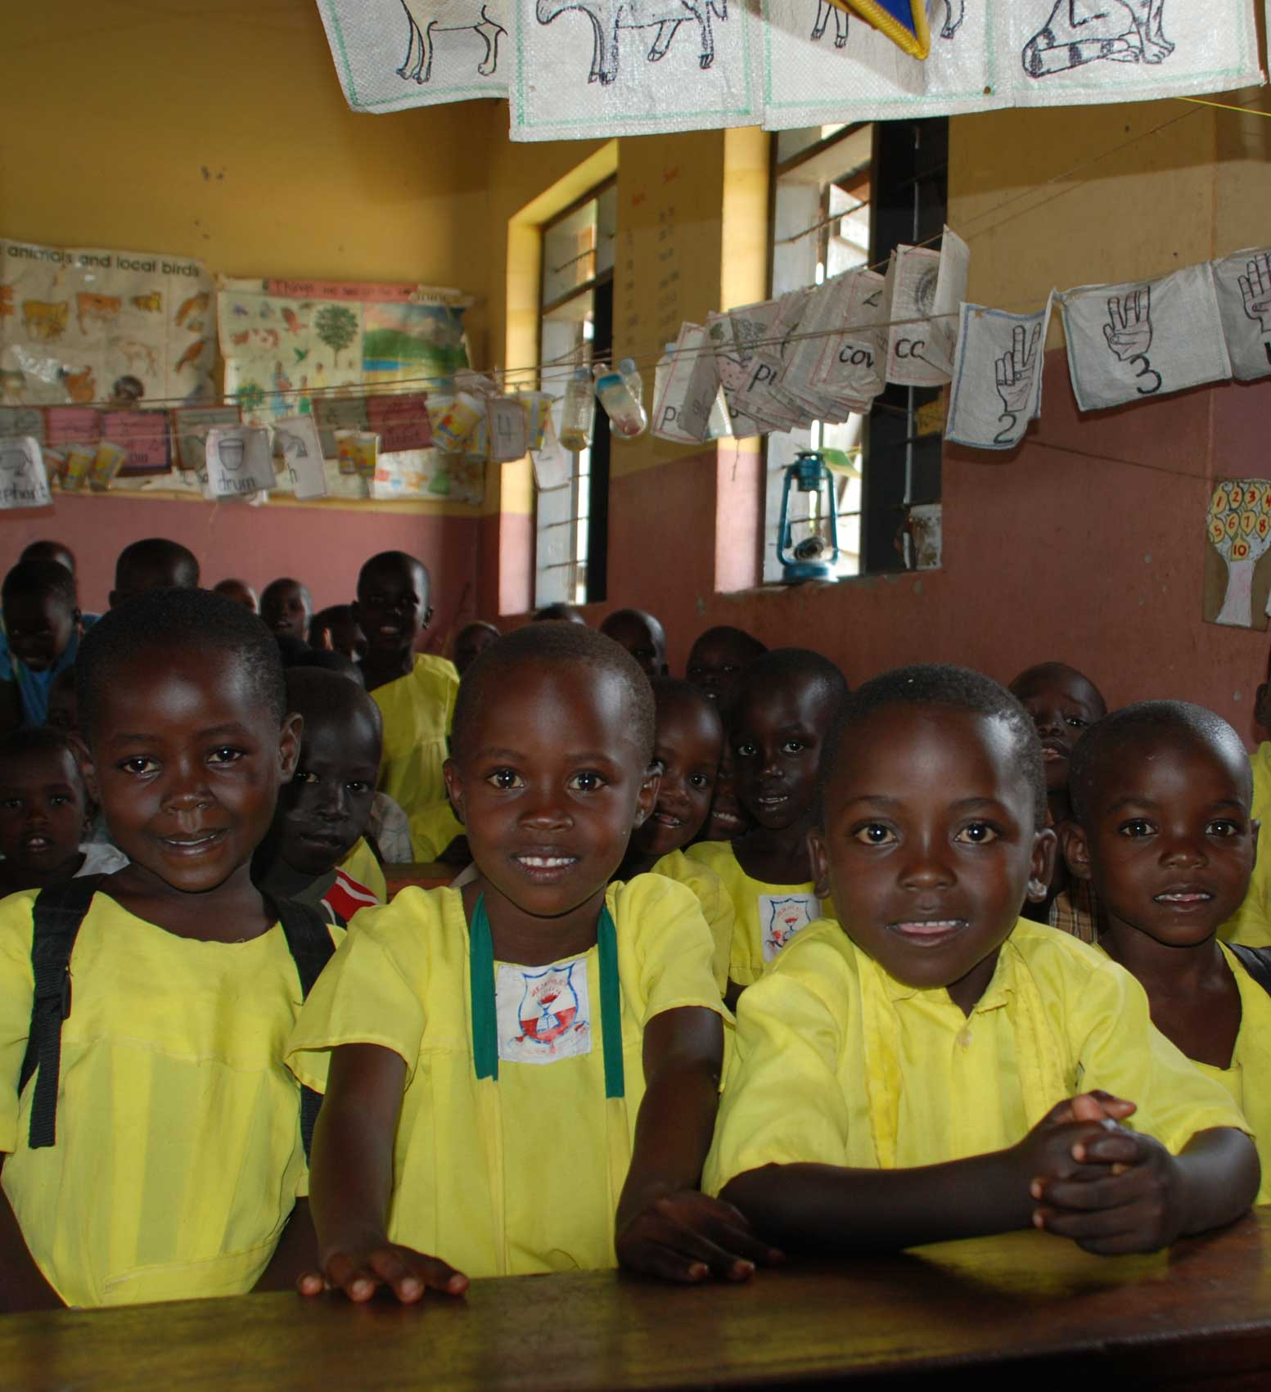
You can help
With your help we can make sure that children in rural Kenya and Uganda have the same opportunities to go to school as children in the UK.
build-africa.org
Notes:
www.build-africa.org/school-fundraising

Slide 41
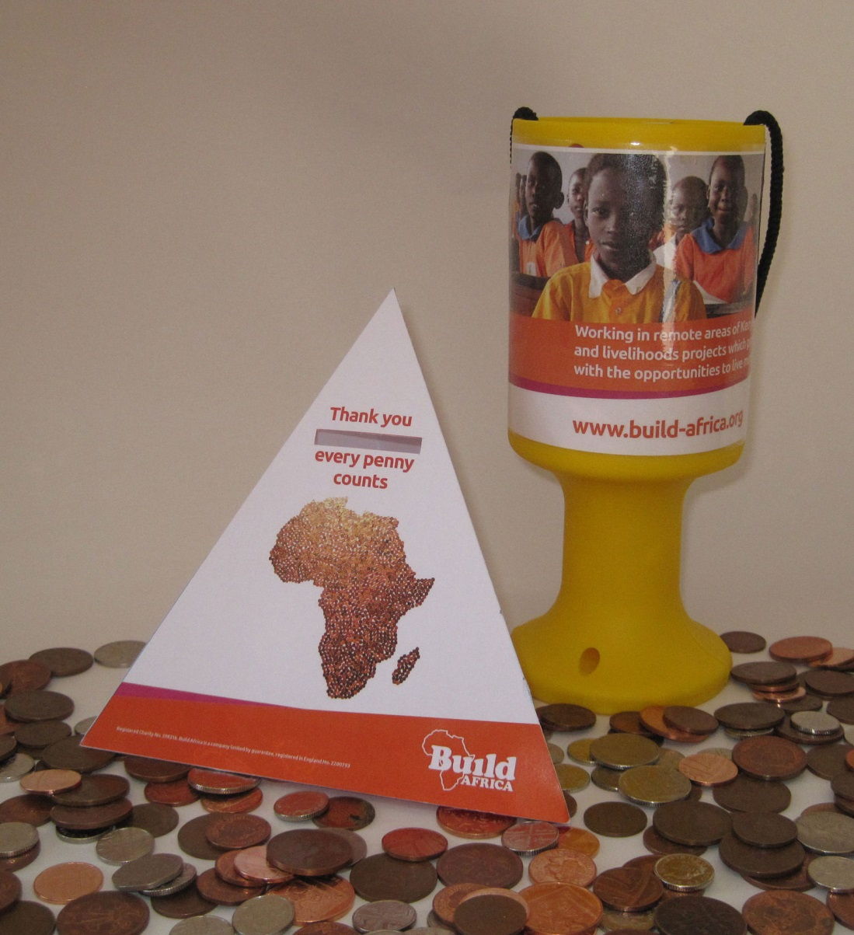
You can help
You could have lots of fun raising money to help Build Africa change lives!
build-africa.org
Notes:
There are lots of things you could do to help Build Africa …
You could have lots of fun raising money– have you ever done a sponsored walk? Or had a dress up day at school? What about a School Quiz? Or cake sale to raise money?
By telling all your family and friends about what we are doing together, more people get to hear about Build Africa and learn about the work we are doing. The more people who know, the more money we can raise, and the more children we can help to get a good education. Who knows, with a good education, a future President of Kenya or Uganda may come from a school, helped by the money that you have raised!
Build Africa has lots of ideas to help you raise lots of money and have lots of fun at the same time!

Slide 42
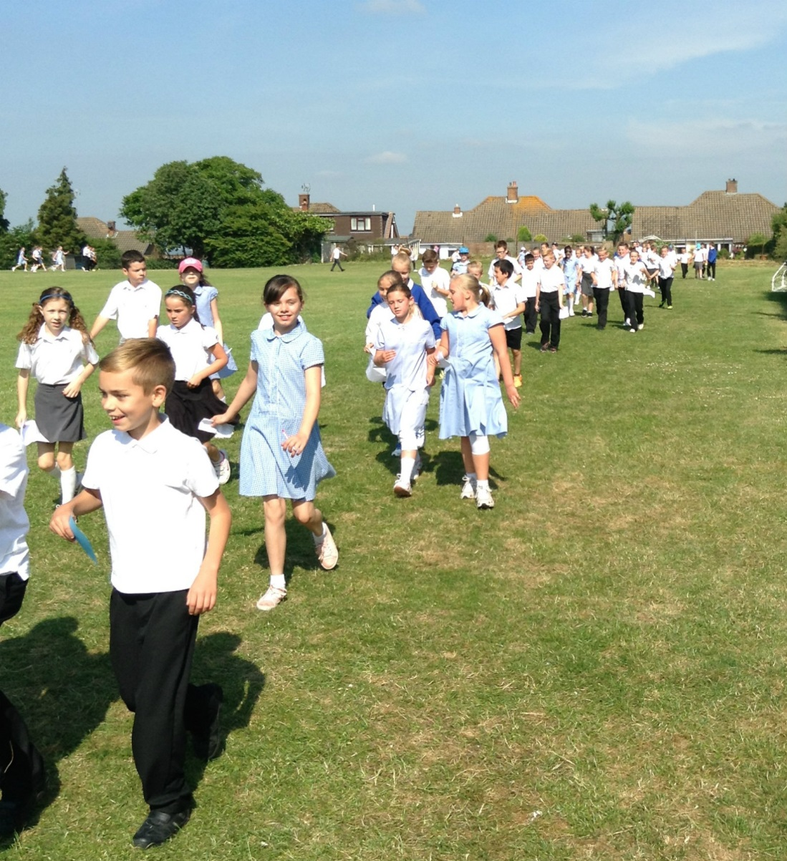
You can help
You can raise money by …
Doing a sponsored walk
Having a dress up day
Holding a cake sale
build-africa.org
Notes:
There are lots of things you could do to help Build Africa …
You could have lots of fun raising money to help children get a good education– have you ever done a sponsored walk? Or had a dress up day at school? What about a School Quiz? Or cake sale to raise money?
By telling all your family and friends about what we are doing together, more people get to hear about Build Africa and learn about the work we are doing. The more people who know, the more money we can raise, and the more children we can help to get a good education. Who knows, with a good education, a future President of Kenya or Uganda may come from a school, helped by the money that you have raised!
Build Africa has lots of ideas to help you raise lots of money and have lots of fun at the same time!

Slide 43
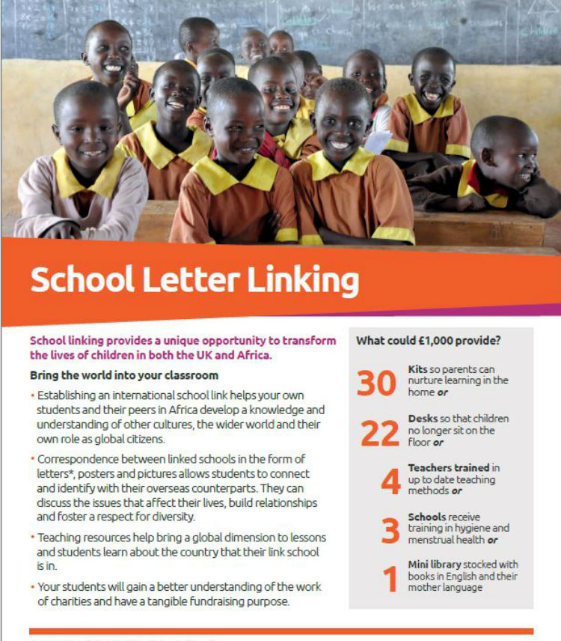
Build Africa can help you too!
Whether you are planning a one off event or would like to link with a school in Africa, we will work closely with you and provide all the information you need to keep students, parents and teachers engaged and motivated.
build-africa.org
Notes:
School linking provides a unique opportunity to impact the lives of hundreds of pupils in both the UK and Africa. Not only will your pupils learn about global citizenship issues, but the financial support provided to your linked school will have a life-changing impact.
Find out more about our School Linking Programme … www.build-africa.org/school-linking

Slide 44
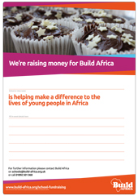
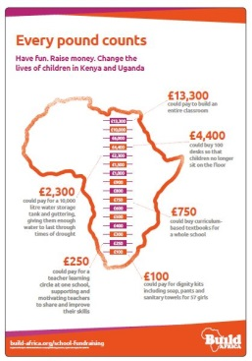
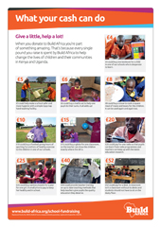
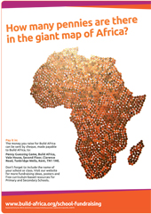
Supporting your fundraising
We have great materials to make your fundraising activities a success:
A - Z School Fundraising Ideas Sponsorship Forms
Penny Guessing Game Fundraising Posters Collection Boxes Balloons
build-africa.org
Notes:
Whether you are planning a one off event or would like to link with a school in Africa, we will work closely with you and provide all the information you need to keep pupils, parents and teachers engaged and motivated.
Available to download off the website … http://www.build-africa.org/school-fundraising-resources
Or ask us for printed copies of the fundraising pack, as well as Build Africa balloons and collection tins for your events.
Raise awareness about Build Africa
By telling all your family and friends about what we are doing together, more people get to hear about Build Africa and learn about the work we are doing.
The more people who know, the more money we can raise, and the more children we can help to get a good education.
Who knows, with a good education, a future President of Kenya on Uganda may come from a school, helped by the money that you have raised!

Slide 45
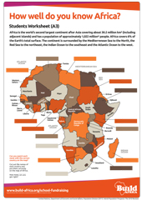
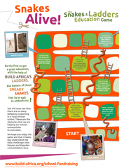
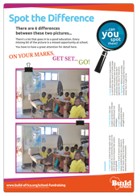
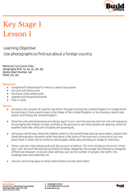
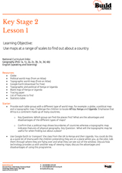
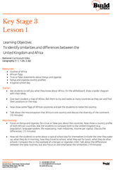
Supporting your fundraising
And free curriculum-based resources to help teachers engage students and ensure they understand the cause they are supporting
Map of Africa Game Primary Key Stage One
Snakes and Ladders Game Primary Key Stage Two
Spot the Difference Secondary Key Stage Three
build-africa.org
Notes:
Whether you are planning a one off event or would like to link with a school in Africa, we will work closely with you and provide all the information you need to keep pupils, parents and teachers engaged and motivated.
Available to download off the website … http://www.build-africa.org/how-you-can-help/fundraise/school/teachers-resources
Or ask us for printed copies of the fundraising pack, as well as Build Africa balloons and collection tins for your events.
Raise awareness about Build Africa
By telling all your family and friends about what we are doing together, more people get to hear about Build Africa and learn about the work we are doing.
The more people who know, the more money we can raise, and the more children we can help to get a good education.
Who knows, with a good education, a future President of Kenya on Uganda may come from a school, helped by the money that you have raised!

Slide 46
Every pound makes a difference
What your cash could do
£200 could provide text books and learning resources, such as educational games and visual aids, for one class
£500 could provide a handwashing station, so children have a clean and hygienic place to wash their hands
£2,000 could equip 100 parents, who may not have an education themselves, with practical skills to help their children learn at home
£9,750 could build a safe and hygienic toilet block with 8 latrines
£11,700 could pay for a new classroom block for one year group, providing a safe, reliable and accessible place for them to learn.
build-africa.org

Slide 47
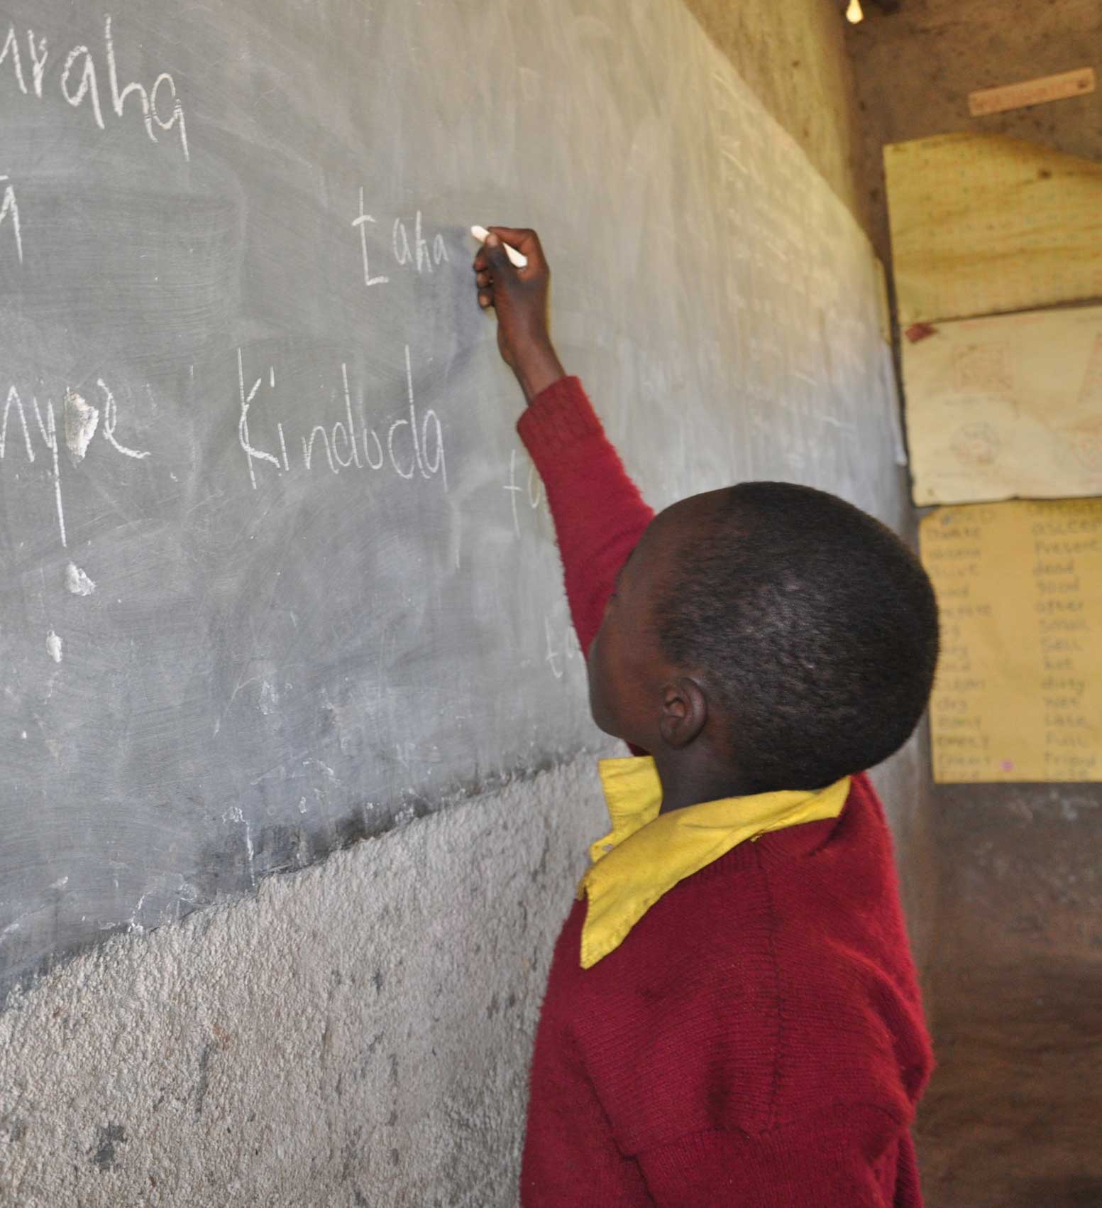
Every pound makes a difference
The more money you raise for Build Africa the more people we are able to help.
build-africa.org
Notes:
Raise awareness about Build Africa
By telling all your family and friends about what we are doing together, more people get to hear about Build Africa and learn about the work we are doing.
The more people who know, the more money we can raise, and the more children we can help to get a good education.
Who knows, with a good education, a future President of Kenya on Uganda may come from a school, helped by the money that you have raised!

Slide 48
For more information
For more information about fundraising for a school in Africa please contact:
Laura Perratt
on
01892 519 619
or email
schools@build-africa.org.uk
build-africa.org
Notes:
For more information about fundraising for a school in Africa please contact Laura Perratt on schools@build-africa.org.uk or 01892 519 619.
Watch our videos to learn more about Build Africa:
A story about problem solving: https://www.youtube.com/watch?v=a5mIw8Oerag
Time machine: https://www.youtube.com/watch?v=roTcOzCy4hE
Literacy is the start of the story: https://www.youtube.com/watch?v=mftz1xdErdw

Slide 49
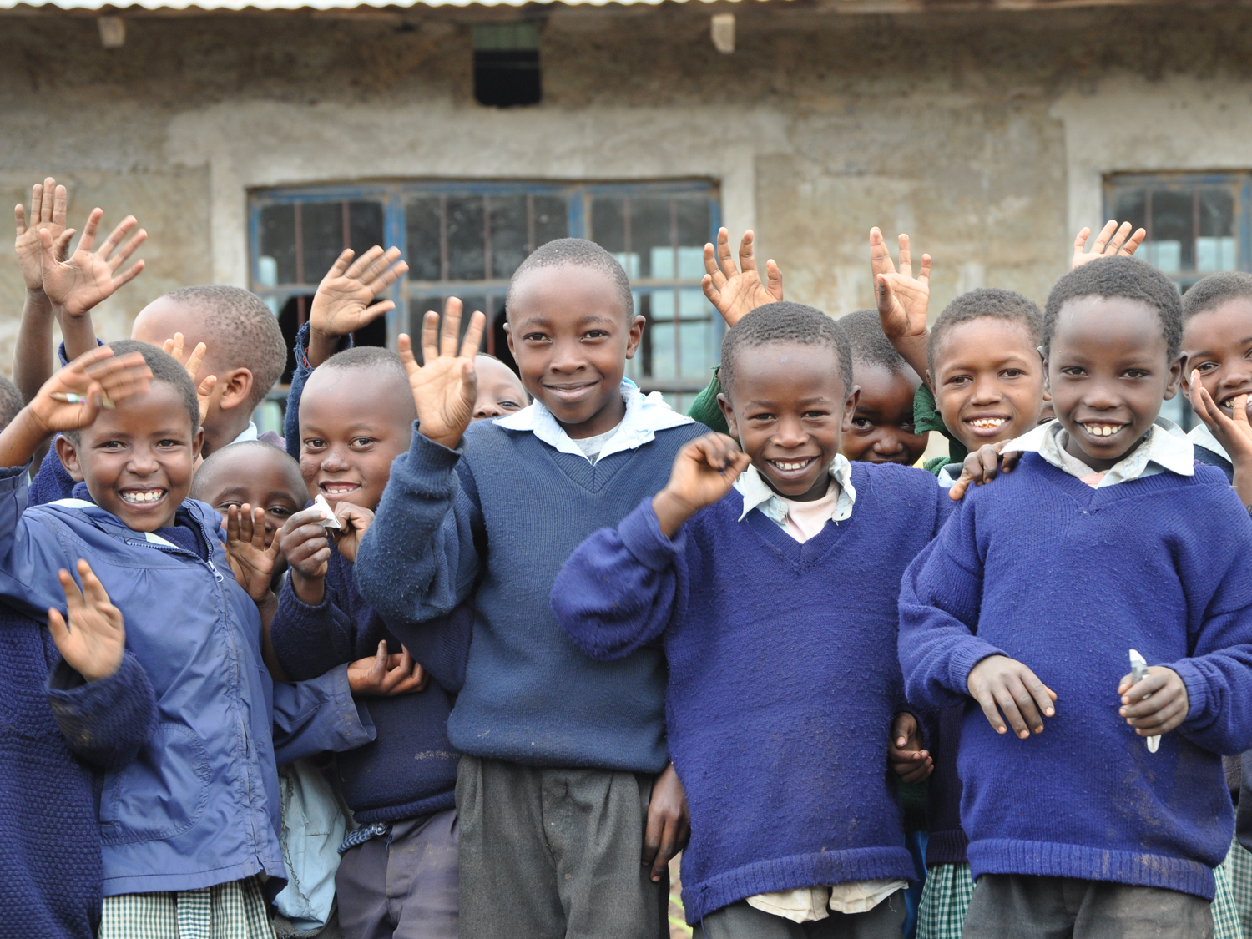
Asante! Thank you!
build-africa.org
Notes:
Thank you!

